Slide 1
Network Entropy and the Cancer Cell
Local and global cancer hallmarks and applications

Slide 2
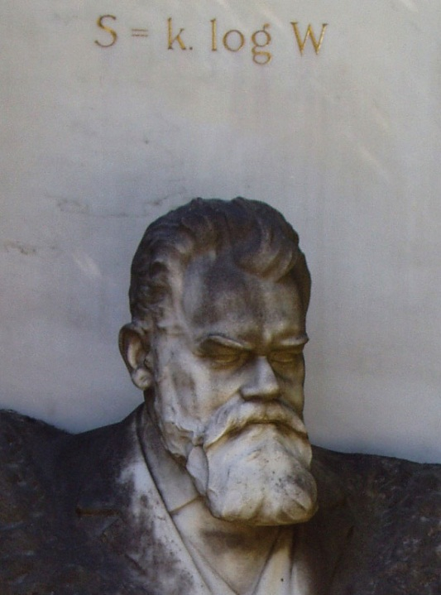
Contents
Cancer research in the 21st century
Entropy in gene expression
Entropy in copy number
Conclusions

Slide 3
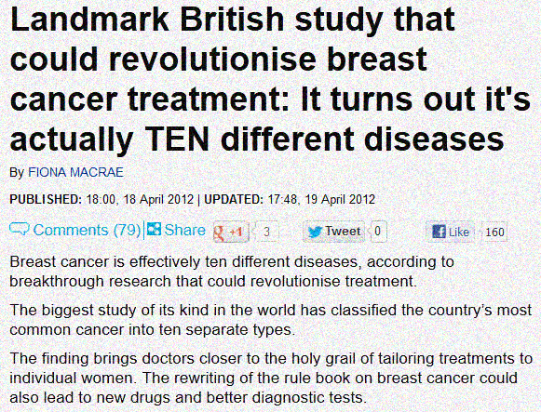
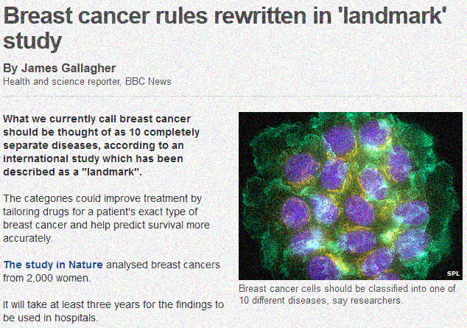
1. Cancer research in the 21st century
Three reasons why we haven’t cured cancer
Cancer consists of an unknown number of sub-types whose origins and conditions are not well known: which genes and cellular functions are important?
Daily Mail
BBC

Slide 4
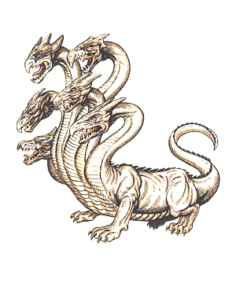
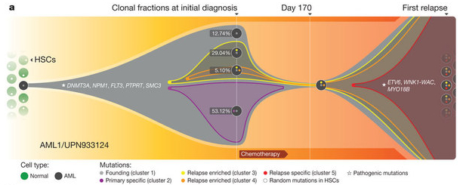
Three reasons why we haven’t cured cancer
A given tumor tends to consist of many different sub-populations. Thus any treatment tends to be like cutting off some of the heads of a hydra.
A relatively minor subpopulation of tumor cells survives chemotherapy and arises to become the dominant sub-type at relapse
Ding et al, Nature 2012

Slide 5
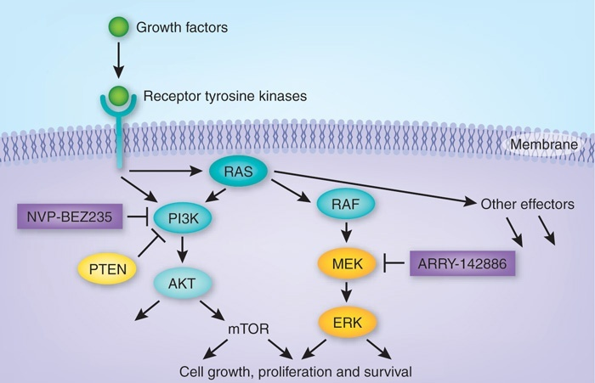
Three reasons why we haven’t cured cancer
Most often cancer is driven by alterations in a complex gene network. The biological picture of the network state is still largely incomplete.
In ordinary tumors with RAF activated you only need to inhibit MEK to put the cancer into remission.
But when RAS is mutant, you have to inhibit PI3K and MEK!
In this case knowing the transduction pathway involved gives biological understanding to why treatments work.
Unfortunately, these are not known for most pathways!
Engelmann et al, Nature Med. 2008

Slide 6
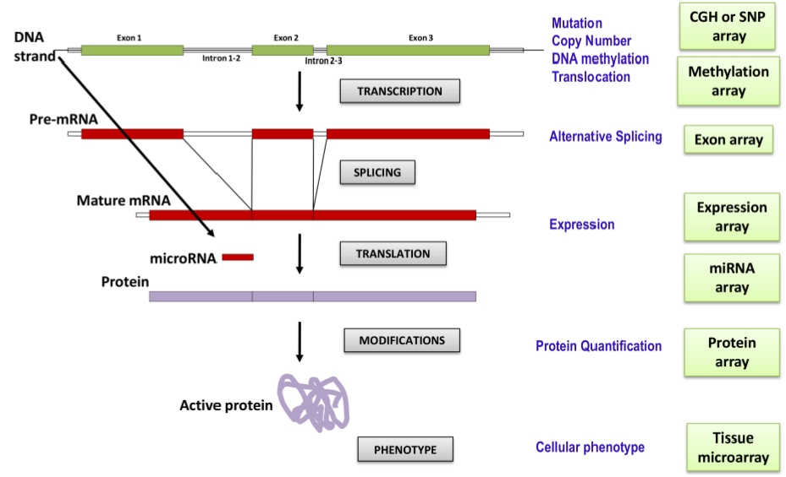
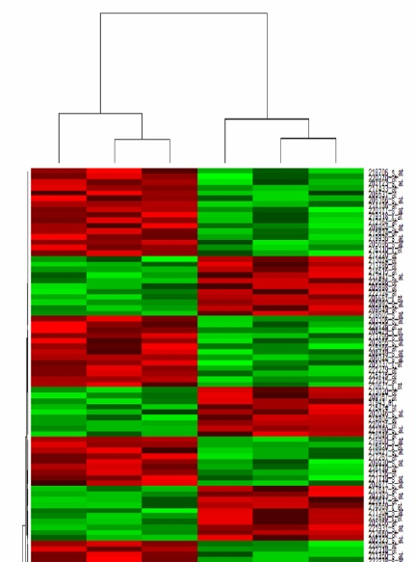
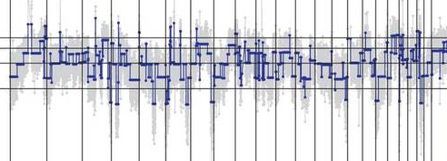
Modern tools in cancer genomics
We now have the technology to study cancer at the level of entire genomes:
Copy
number
Gene
expression

Slide 7
Finding cancer genes: the traditional approach
Given genomic disease data it is natural to ask which parts of the genome are different in the disease and how that has affected the biological function of the system.
Rank genes according to size of change and select those such that only 5% are expected to be false positives.
Check to see which known biological functions of the cell contain significantly many of these genes. Control for false discovery!
The network structure is ignored in this approach

Slide 8
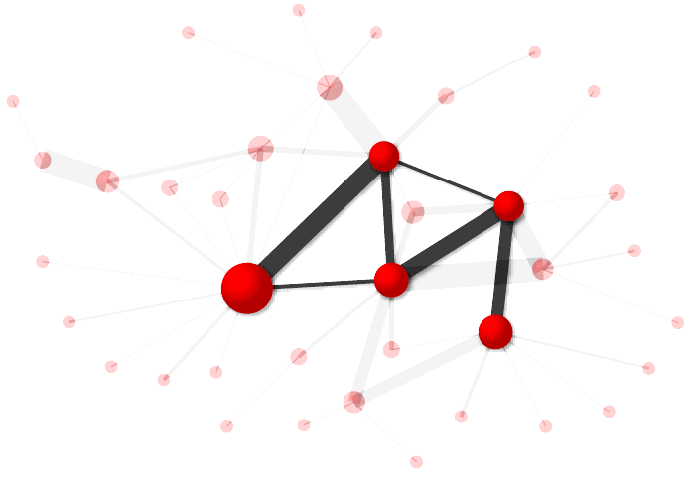
Network approaches in cancer
It is now known that most cancers are not caused by malfunctions in a single protein.
In fact most tumors are characterized by hundreds of alterations (copy number, DNA methylation, …), often of different unknown levels of importance (drivers vs passengers).
To address this challenge, biological data are often combined with interaction network models, giving rise to so-called integrated approaches.

Slide 9
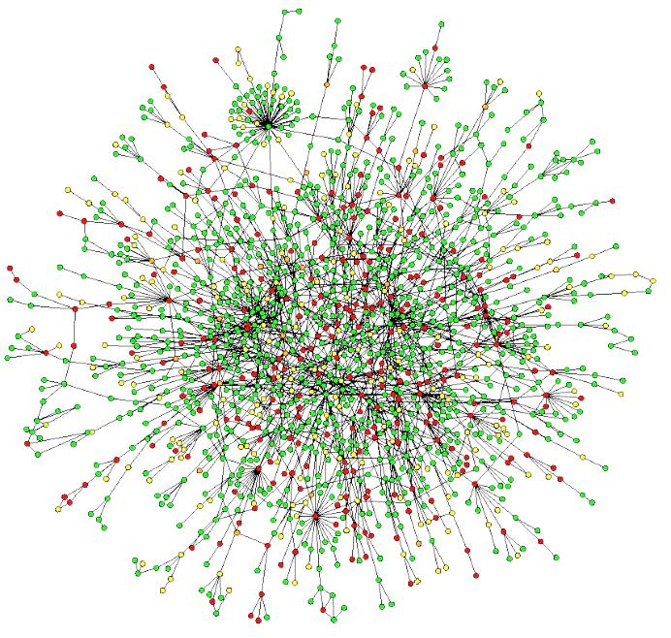
The protein interaction network (PIN)
The approximately 20,000 genes in the human genome are synthesized into proteins. These proteins interact, although we believe ourselves only to know a small proportion of all interactions; perhaps only 10%.
The current interaction network models are obtained from agglomerating results of vast amounts of experiments.
http://www.pathwaycommons.org/
It is believed that around 50% of the interactions in the yeast protein interaction network are known.

Slide 10
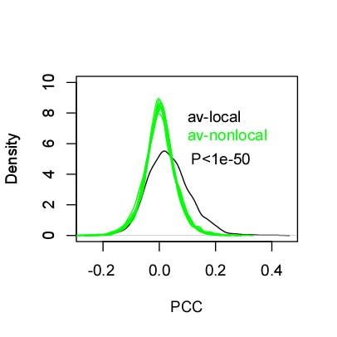
Integrated expression-PIN networks
Proteins that interact are in general more correlated at the expression (mRNA) level:
Example: normal bladder tissue
(around 40 samples)

Slide 11
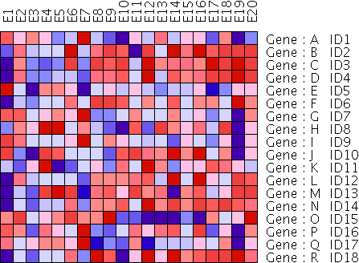
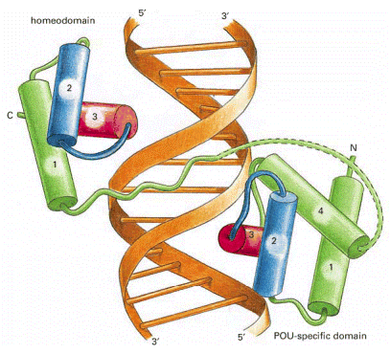
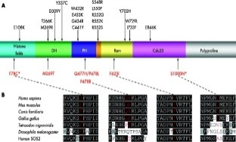
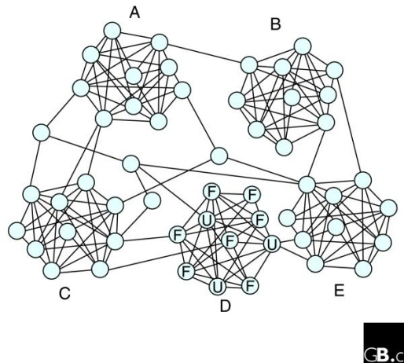
Integrated expression-PIN networks in cancer
PINs (knowledge & predicted)
Normal gene expression
Cancer gene expression
Experiment
Domain Analysis
Homology (common ancestry)
Which local and global network properties best define the cancer phenotype?
Normal network
Cancer network

Slide 12
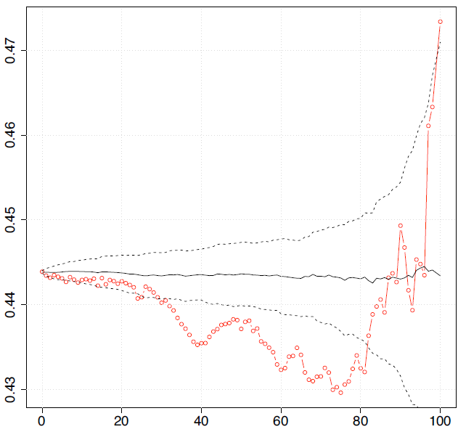
Advantages of network approaches
Improved interpretation: networks provide a biological context to interpret data like gene expression and copy number. For example, the network approach has uncovered subnetworks whose individual properties help to make predictions about cancer.
Taylor IW Nat Biotech 2009
Teschendorff BMC Syst Bio 2010
Noise reduction: using the eigendecomposition of the graph Laplacian may help remove noise in the data.
Rapaport BMC Bioinformatics 2007
Improved prognostic models: network allows more robust identification of relevant prognostic markers.
Chuang Mol Syst Bio 2007
Data most coherent with 75% of eigenvalues removed
Similar random networks
Incoherency of unsupervised prediction
% eigenvalues removed

Slide 13
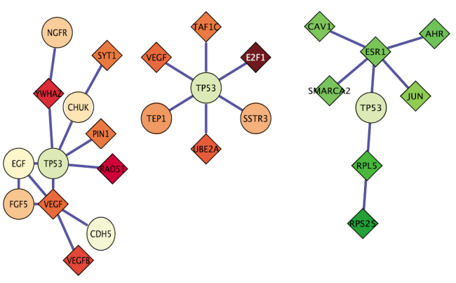
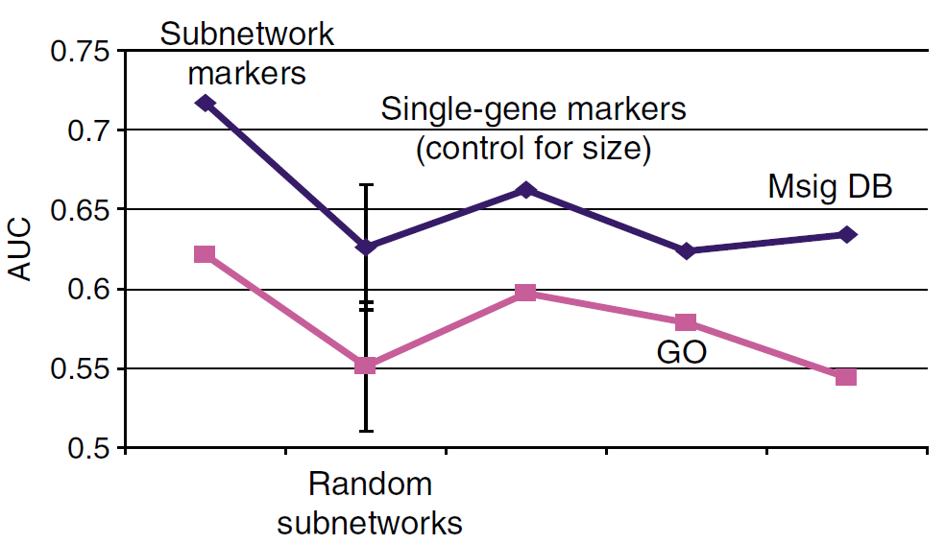
A network approach to improving classification
Chuang et al used the mean expression levels of subnetworks of the PIN as features in a classifier to predict whether breast cancers would spread (metastasize).
Subnetwork markers
Area-Under-Curve performance
Classifier
Build classifier
(mean expression levels of subnetwork markers)
Test 1
Test 2
Chuang et al, Mol Syst Bio, 2007

Slide 14
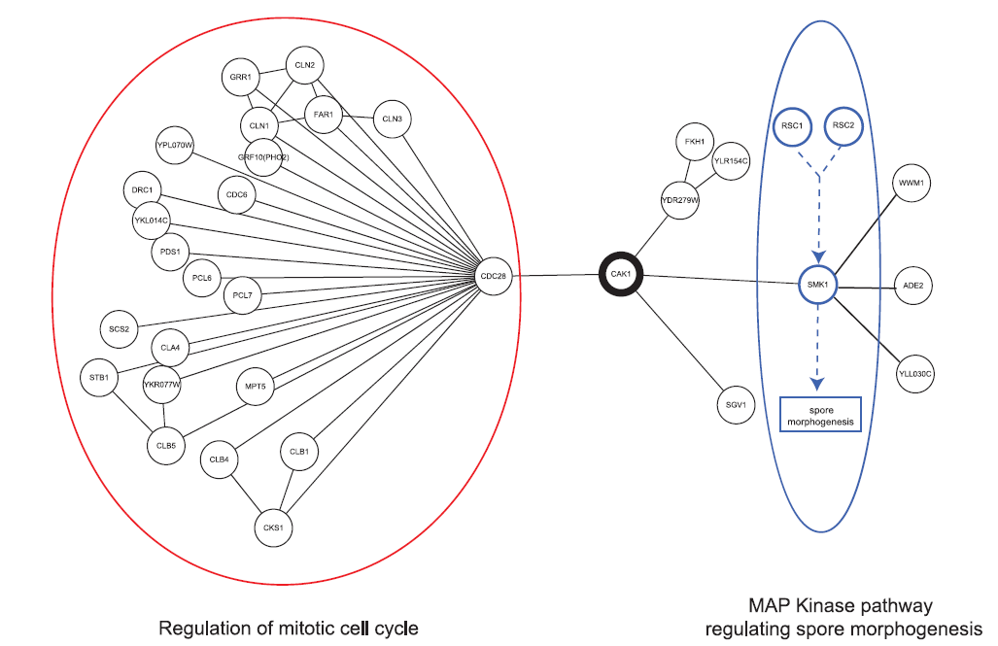
Properties of individual genes
Unsurprisingly, simple topological properties of proteins in the PIN have been associated with function.
In yeast, it was found that betweenness is a more effective indicator of “essentiality” (i.e. the organism either dies or ceases growth without it) than degree.
The protein CAK1P in yeast, an essential, but low-degree protein of high betweenness.
CAK1P
Gerstein et al, PLoS Comp Bio 2007

Slide 15
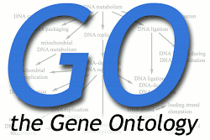
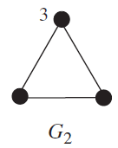
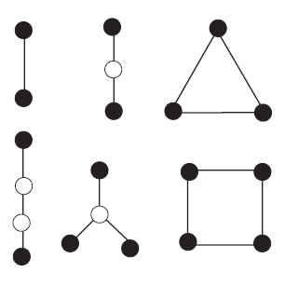
Properties of individual genes
By representing the structure of the network near a protein in terms of some of the different possible sub-networks containing it (viewed as sub-networks of the PIN), it is possible to predict the protein’s function.
=
5
2
8
2
0
5
Predict what sort of thing the protein does: e.g. aid in killing the cell, fix the DNA, communicate between cells, etc.
Protein of
interest
Compute the number of copies of each of these networks that include your protein of interest
Pick a subset of the set of networks (graphs)
Classifier
Kuchalev et al, J R Soc Interface 2010

Slide 16
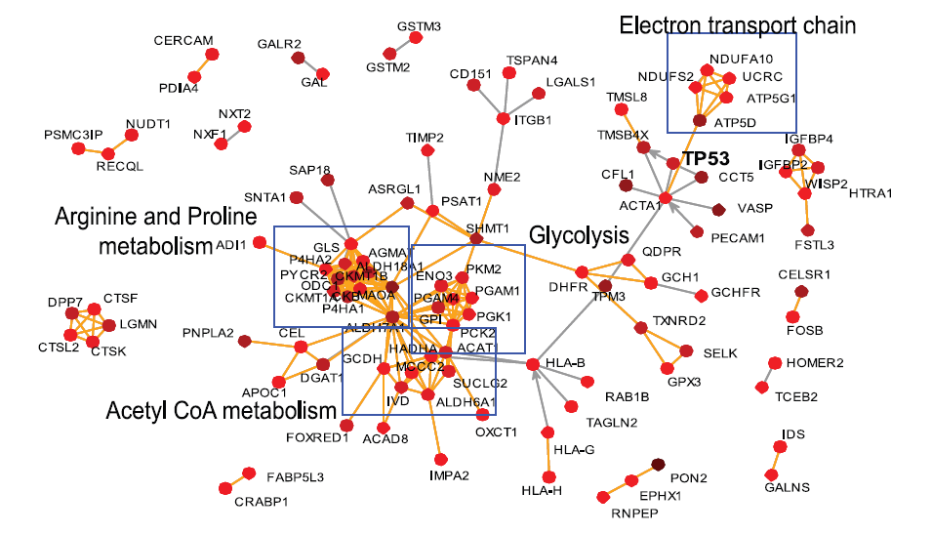
Dynamics on the PIN
Given weights on either the vertices (genes) or edges (interactions) in the PIN, there are several natural constructions giving rise to random walks.
Komurov used the invariant measures (after adjustment) of walks coming directly from the expression-PIN to understand response to DNA damage.
Invariant measure re-scaled to avoid great bias towards hubs
Komurov et al, PLoS Comp Bio 2010

Slide 17
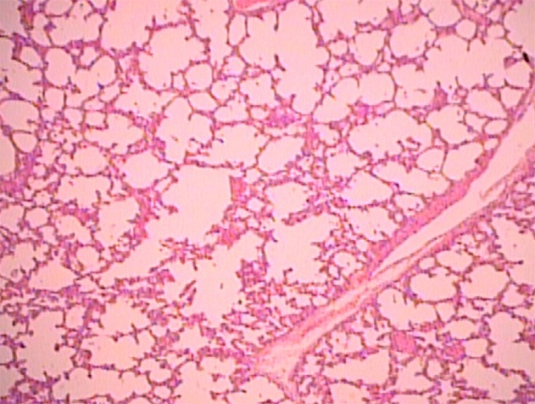
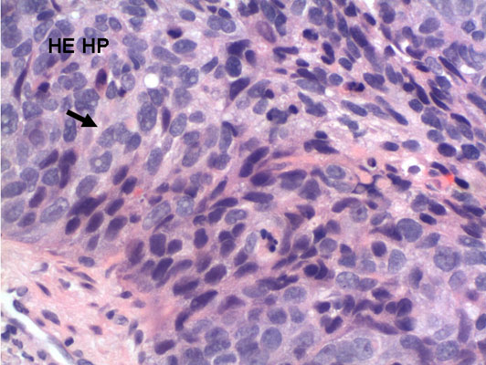
2. Entropy in Gene Expression
Motivation
Want to find a new framework to find genes responsible for “driving” cancers.
At present rather little is known that distinguishes generic normal tissue cells and cancerous cells at the systems level, in particular of protein-interactions and expression (mRNA) levels.
We investigate this by looking to see if changes in the information content across various notions of what might be called “molecular entropy” to distinguish normal and cancer tissues.
Normal lung tissue
Cancerous lung tissue

Slide 18
A random walk on the PIN
Given interacting proteins i and j, their correlation C_{ij} across samples of a given phenotype gives a weight on the edge between them.
Scaling this to be non-negative, as w_{ij} = (1+ C_{ij})/2 (or perhaps |C_{ij}|), we obtain a random walk on the PIN by normalizing to obtain a probability p_{ij} of walking from i to j

Slide 19
The choice of walk
With the choice of edge weight w_{ij} = (1+ C_{ij})/2 we force the random walk to flow like information would flow through the system; in the direction of signal transduction paths and away from inactive or possibly inhibitory interactions.
The choice of edge weight w_{ij} = |C_{ij}| is also valid, but treats inhibition and activation equally.
Information flow in direction of signal
Flow blocked by inhibitory interaction

Slide 20
Molecular entropy
Observe that the walk probabilities emanating from a vertex (protein) gives a probability distribution corresponding to that gene.
We refer to the Shannon entropy of this, i.e.
as the molecular flux entropy of the protein i.
The Shannon entropy in a sense measures the predictability of the walk: on a finite set of values, a uniform distribution is least predictable, and a distribution always taking the same value the most.

Slide 21
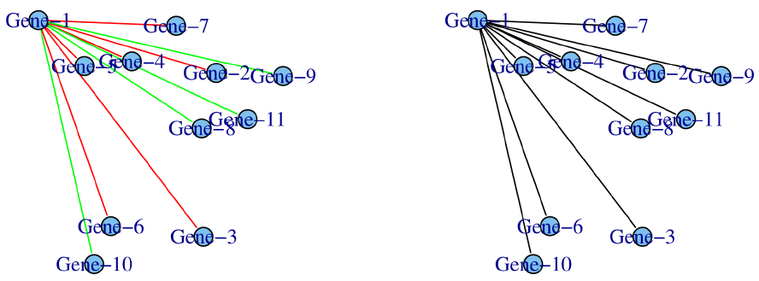
Information loss in the cancer cell
Significant increases were observed in the transitions from normal to cancerous to metastatic cancers (those which have spread). This was observed to be the case across several cancer types.
Non-metastatic
Metastatic (cancer has spread)
Gene-1 inactivated in metastasis leads to loss of correlations and greater entropy
Teschendorff & Severini BMC Systems Biology 2010

Slide 22
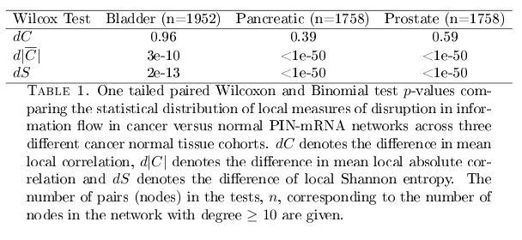
Information loss in the cancer cell
Compared to the average local correlation, (i.e. the mean correlation of a node with its nearest neighbors) and the mean local absolute correlation, the molecular entropy was a better distinguisher of normal, cancer and metastatic cancers.

Slide 23
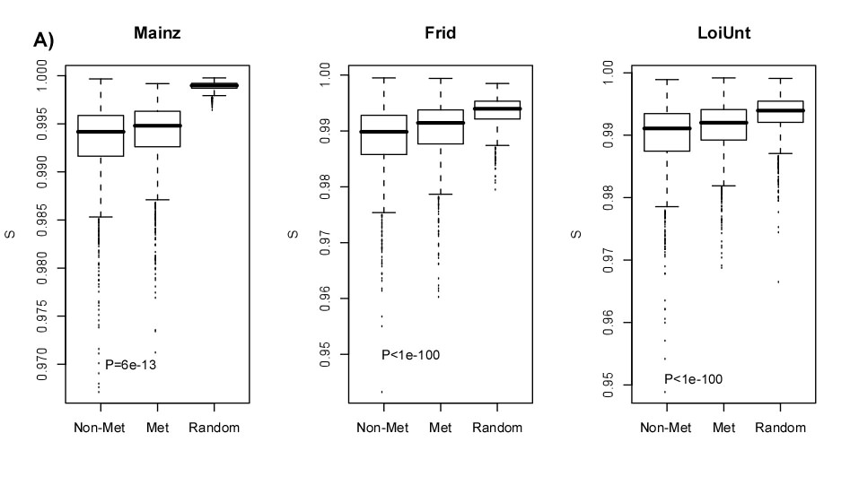
Information loss in the cancer cell
As a sanity check: the Shannon entropy was also higher in randomised null networks in which the expression values were randomly permuted among nodes in the PIN.
Entropy is higher in primary breast cancer tumors that have spread (metastasized)
Teschendorff & Severini BMC Systems Biology 2010

Slide 24
Dynamical entropy over longer distances
The previous notion of molecular entropy obtained weights from the correlations in two different phenotypes and computed the disorder of these (after slight adjustment) looking only at immediate neighbors.
Observe that the k^{th} power of the stochastic matrix p = (p_{ij}) gives the information flow over distances of length k.
The total information flow of various distances between two genes can be obtained by taking a choice of linear combination of powers of p.

Slide 25
A natural combination of powers
Motivated by statistical physics, we introduce a temperature parameter t and consider the family of matrices K(t) obtained as
This series converges and satisfies a modified heat diffusion equation

Slide 26
Heating it up
In the “hot” temperature limit, this indeed approximates a solution of the heat diffusion equation
For each t we may write down a “global” entropy S(t) of the information flux as
where Q is the number of non-zero entries of K.
We refer to this as the global flux entropy.
West et al Submitted 2012

Slide 27
Covariance entropy
Before studying the flux entropy further, we introduce another notion recently studied.
The covariance entropy quantifies the degree of similarity between samples as determined by their Pearson correlations, first considered in the context of gene expression by van Wieringen and van der Vaart.
They argue that with the accumulation of copy number aberrations in cancer, there should be an increase in genomic entropy. For this to be cancerous, this should be reflected in expression.
van Wieringen et al Bioinforrmatics 2011

Slide 28
When does entropy in copy number lead to entropy in expression?
DNA copy number
S(N) < S(C)
X
?
mRNA expression
Y = g(X)
S(N) < S(C)
Entropy in normal phenotype
Entropy in cancer phenotype
Proposition:
Van Wieringen et al Bioinformatics 2010

Slide 29
Computing covariance entropy
Modelling gene expression profiles across n samples of g genes as a multivariate normal Y ~ N(μ,Σ), the entropy H(Y) is given by
Letting Σ_{i} be the covariance matrix restricted to gene i leads to the local covariance entropy:

Slide 30
A caveat
The monotone relationship between copy number X and gene expression Y = g(X) may be severely compromised if the measured expression levels are over a mixture of tumour cells and stromal (non-tumor cells).
Normal
Cancer
Normal copy-number
Epithelial cell
Immune cell
Epithelial cell, gene amplified
Normal
Cancer
Low expression
High expression

Slide 31
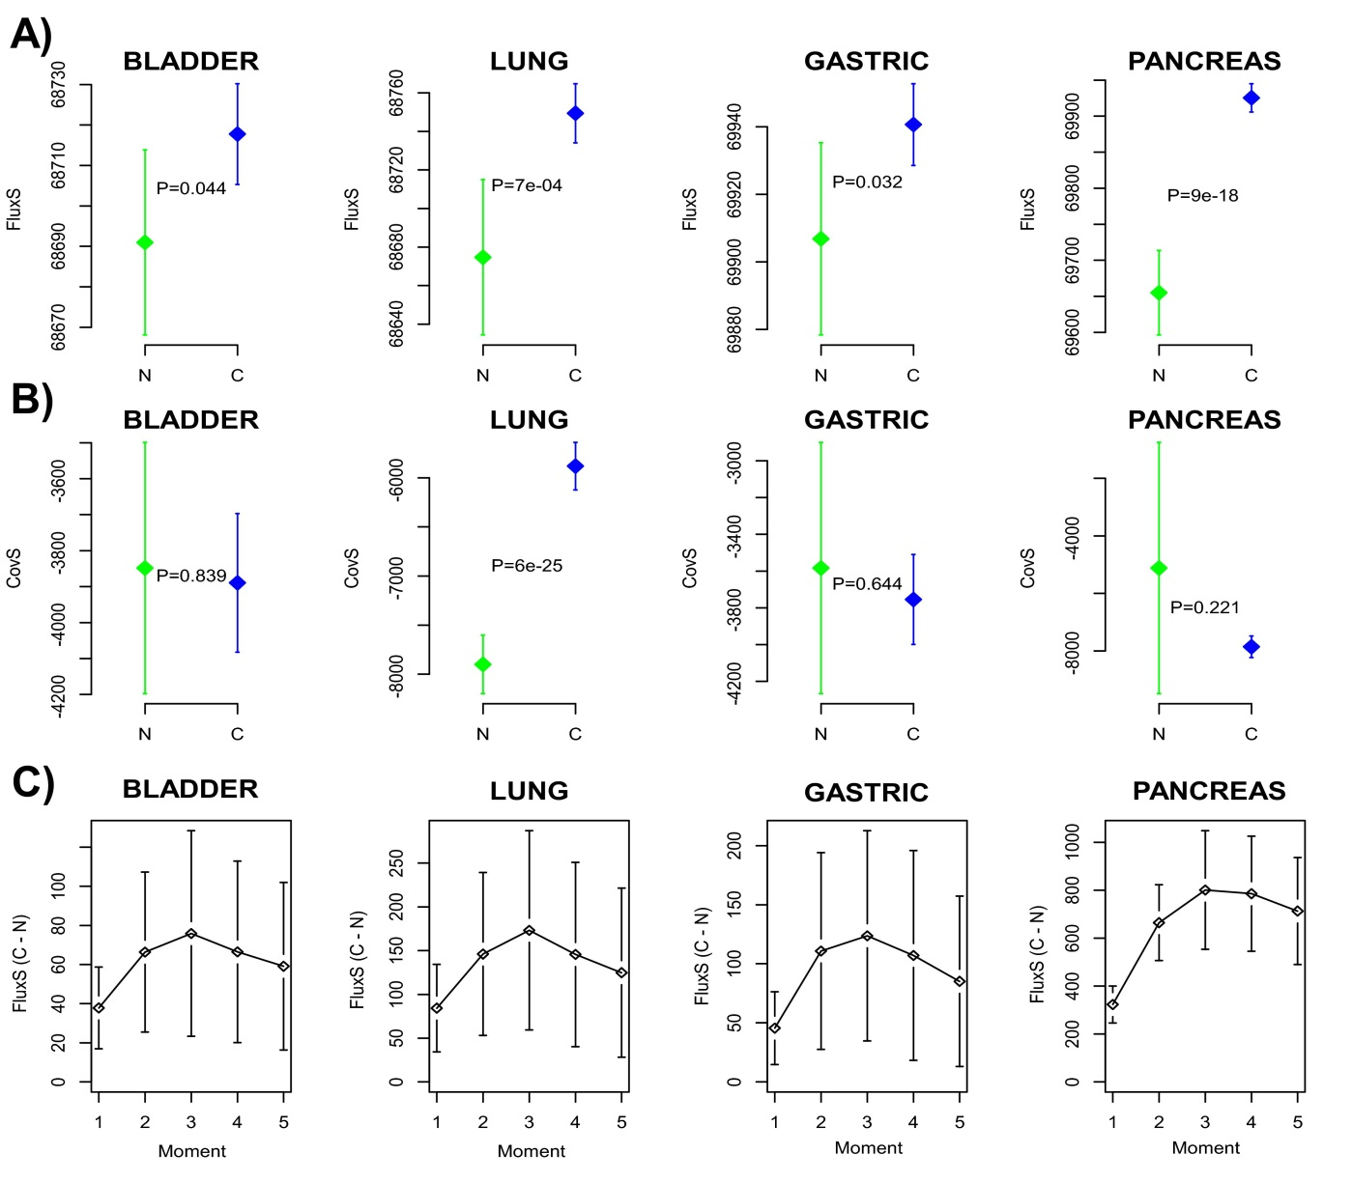
Global information entropy increases
Flux entropy is increased in cancer relative to normal tissue.
Covariance entropy changes inconsistent.
Maximum difference attained for paths in the PIN up to length 3.
West et al Submitted 2012

Slide 32
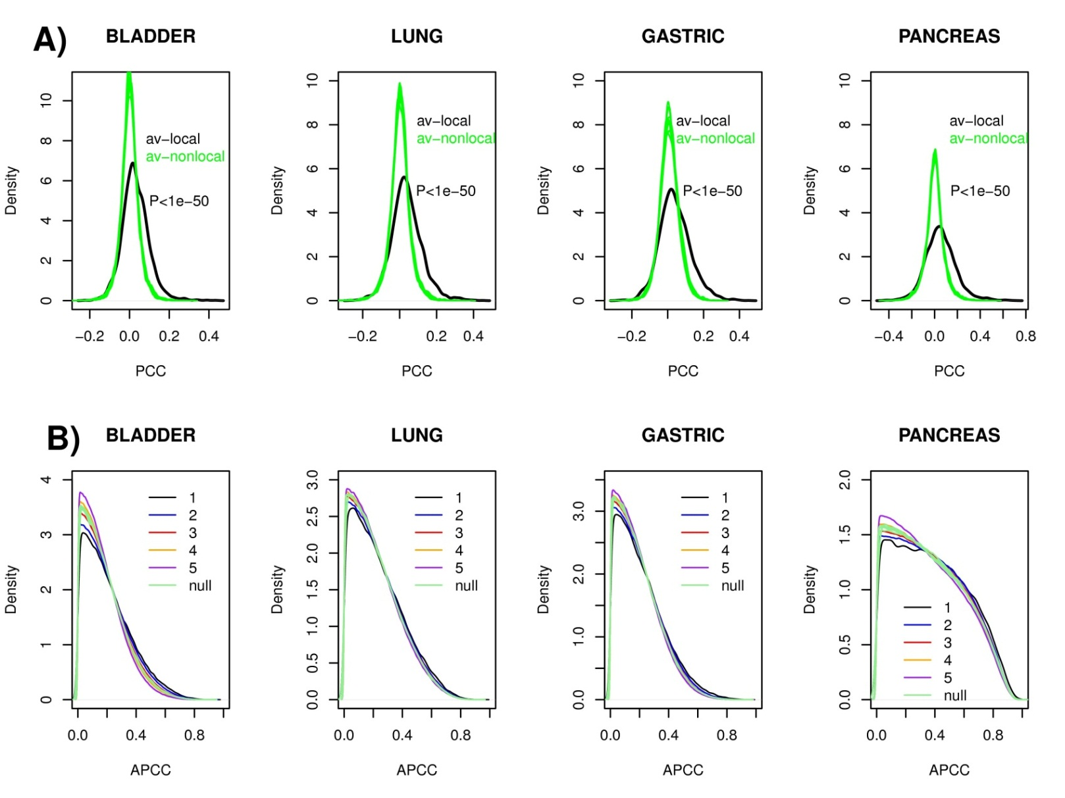
Correlation path length scales
Local correlations stronger in every case.
Natural correlation length scale on the mRNA-PIN is 3.
West et al Submitted 2012

Slide 33
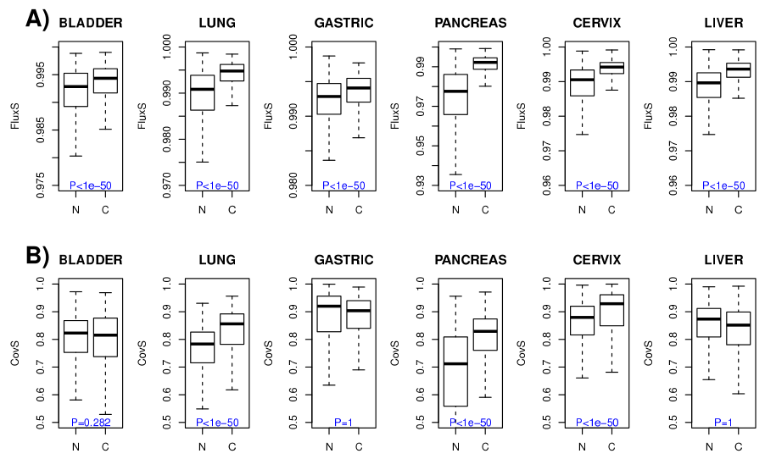
Local flux and covariance entropies
Local flux entropies increased in cancer.
Local covariance entropies not always increased.
Consistent and significant increases in local flux entropy found from normal to cancer tissue.
West et al Submitted 2012

Slide 34
Differential expression and entropy
Hypothesis: alterations in genes “driving” the cancer should lead to disruptions in local and global gene expression patterns causing changes in entropy.
Consequences:
Genes whose inactivation confers selective advantage (tumor suppressors) should tend to show increases in local flux entropy.
Genes that become activated in cancer (oncogenes) can be expected to show reductions.

Slide 35
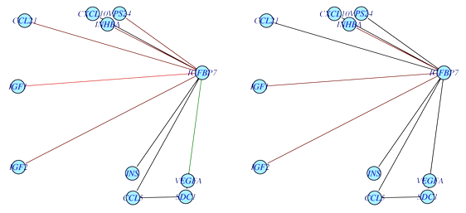
Verifying changes in expression
Genes significantly over-expressed in cancer (P < 0.05) show reductions in flux entropy when compared to genes which were under-expressed.
Binding of IGFBP7 to IGF1 is reduced and there is reduced suppression of VEGFA.
This leads to increased angiogenesis (growth of new blood vessels; a hallmark of cancer) in the metastatic phenotype.
IGFBP7 is putative tumor suppressor; lower expression in cancer. Wajapeyee et al Cell 2008, Oh Y et al J Biol Chem 1996
IGFBP7
IGF1
Non-metastatic
Metastatic (cancer has spread)
Increase in entropy
Teschendorff & Severini BMC Systems Biology 2010

Slide 36
Interpreting flux entropy
The increased flux entropy in cancer may endow cancer cells with the flexibility to adapt to the strong selective pressures of the tumor microenvironment.
The fluctuation theorem of Demetrius et al asserts
ΔRΔS > 0
i.e. there is a correlation between changes in network entropy S and robustness R. As such it is possible that cancer alterations leading to significant increases in flux entropy may contribute to the dynamical robustness of such cancer cells.
Demetrius et al 2004 Physics A 346

Slide 37
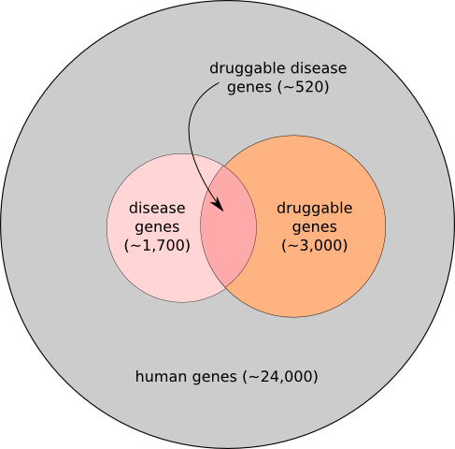
Therapeutic applications
A great problem is that important cancer-related genes are not directly druggable.
In these cases it may be possible to use differential flux entropy to identify neighboring viable drug targets that also exhibit significant reductions in flux entropy.
This computational strategy could therefore guide certain therapeutic strategies that aim to select drug targets within the same oncogenic pathway.
Often genes are not druggable because there are too many similar genes and drugs tend to affect all of them.
?

Slide 38
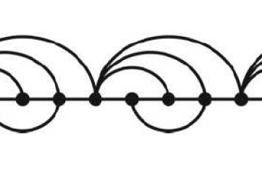
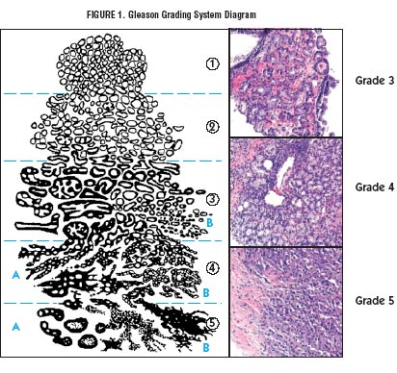
3. Entropy in copy number
Motivation
In this section we use a “combinatorial smoothing” obtained by associating a network known as a visibility graph to copy number data viewed as a time series
Visibility
algorithm
Approx. entropy
Copy
number
Visibility graph
Information about phenotype

Slide 39
Approximate entropy of networks
Much practical work has considered an entropic origin for various properties of complex networks, including biodiversity in ecological networks, the emergence of degree-degree correlations and communities in social and biological networks.
These approaches focus mainly on the ubiquitous Shannon entropy, and to help complete the picture we introduce a notion based around the approximate entropy.

Slide 40
Approximate entropy
The approximate entropy considered by Pincus exists as a finite-sized statistic of the Eckmann-Ruelle entropy proposed to measure the complexity of a system with time evolution.
The approximate entropy ApEn(m,r,N) of a time series u of length N is constructed from the image X_{m} of the Takens map x(t) = u((t),…,u(t+m–1)).
With
define

Slide 41
The Rukhin estimate
Intuition is gained due to the combinatorial interpretation of approximate entropy, due to Rukhin: given a sequence u of length N on S symbols {0, 1, …, S – 1}, let ν(I) be the frequency with which block I occurs. Denoting
the estimate is
Fact: this is a.s. a good approximation of the ordinary approximate entropy of u.
Rukhin, J Appl Probab 2000

Slide 42
Upshot of the Rukhin estimate
As such, on a finite set of symbols, the approximate entropy adds something new, measuring something distinct from the ordinary statistical moments (mean, variance, … ) and the Shannon entropy of the sequence.
It can be (almost surely!) thought of measuring how much data a choice of universal data compressor would use to store the object.

Slide 43
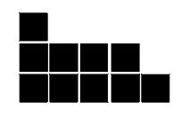
Approximate entropy of a degree sequence
As such for a network, we introduce the slide entropy which is the approximate entropy of a binary sequence encoding something like an “infinitesimal” disorder of the finite degree sequence.
The slide construction is simple: draw the degree distribution as a partition diagram and trace along it from left to right. When you go horizontally one unit write down “0” and vertically one unit, write down “1”.
0
1
0
0
0
01000101
1
0
1

Slide 44
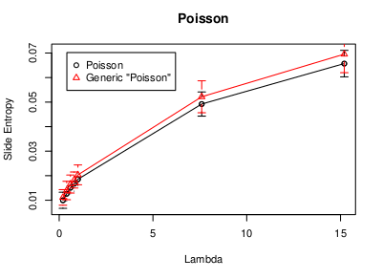
Analytics for the slide entropy
In nice circumstances (almost surely!) approximate entropy of this slide sequence is recovered asymptotically by a Shannon entropy relating the distribution of 0s and 1s in the associated sequence, yielding an analytic formula of empirically measured reasonable accuracy, say for Poisson networks.
Almost surely isn’t always…
West et al, Phys Rev E 2012

Slide 45
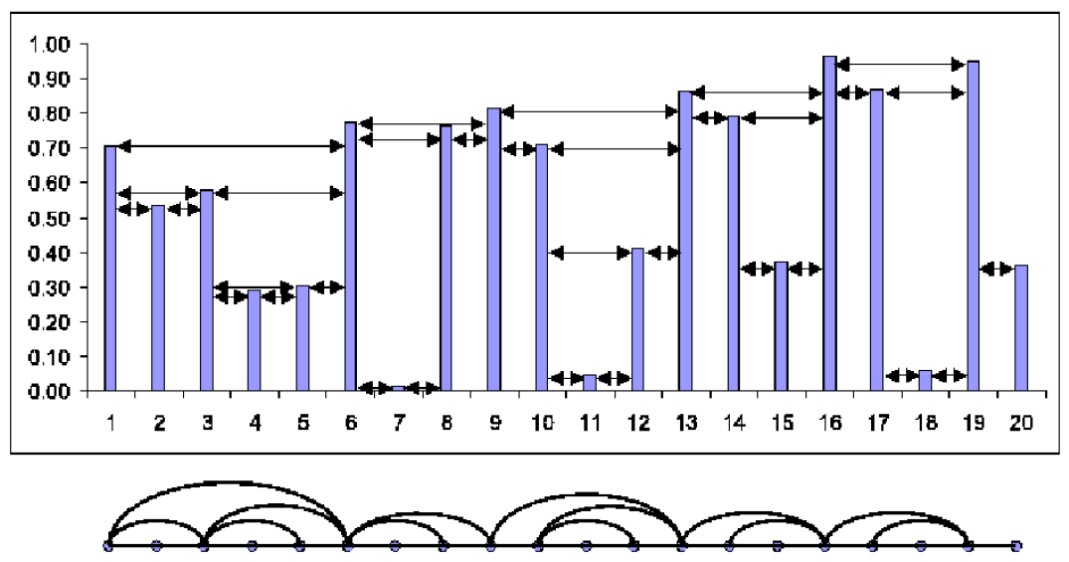
Visibility graphs
Visibility graphs are networks associated to time series that capture features of the time series in their topology.
Time series
Visibility
algorithm
Visibility
graph
Constructing a horizontal visibility graph
Lacasa & Toral, Phys Rev E 2010

Slide 46
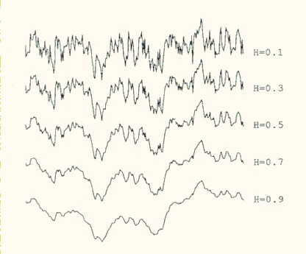
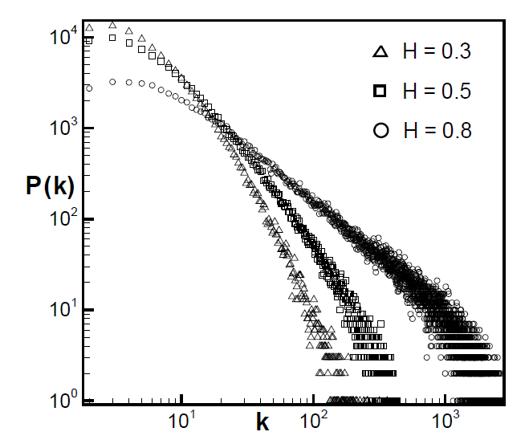
An example application of visibility graphs
A fractional Brownian motion process of Hurst exponent H gives rise to a scale free visibility graph of scale free parameter 3 – 2H.
Degree distribution of associated visibility graph
Fractional Brownian motion (H).
Lacasa et al, arXiv:0901.0888v1 2009

Slide 47
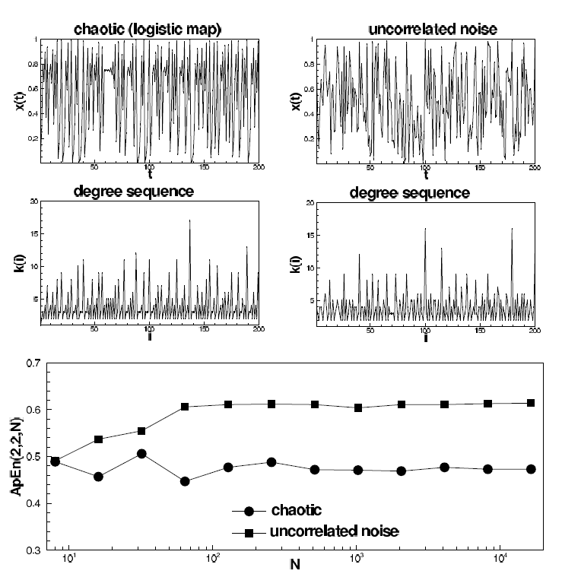
Approximate entropy of visibility graphs
Uncorrelated white noise gives rise to visibility graphs of maximal ApEn (it was known previously also to maximize the Shannon entropy of the degree distribution).
The ApEn of visibility graphs associated to chaotic maps reaches a non-zero value, reminiscent of the underlying attractor of the dynamics.
As such, the network structure also inherits the complexity of the time series.
West et al, Phys Rev E 2012

Slide 48
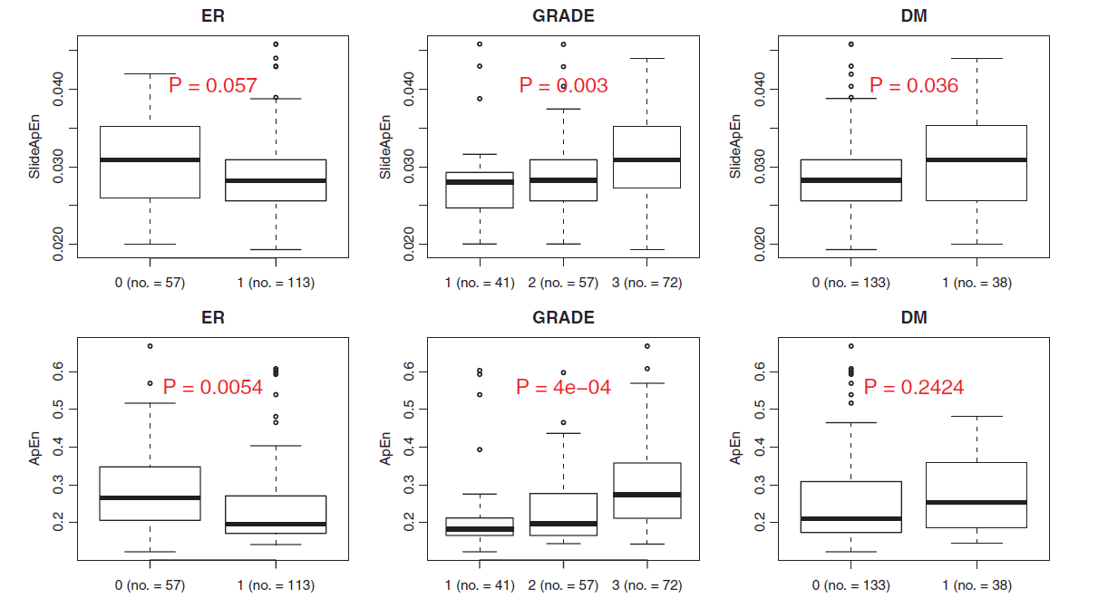
Approximate entropy of copy number data
Significant increases in approximate entropy of slide sequence .
Is the cancer over-expressing estrogen receptors?
How fast growing is the cancer?
Has the cancer spread?
N.B. ER-status, Cancer GRADE and Distal Metastasis all correlate in cancers, but remain distinct phenotypic properties.
West et al, Phys Rev E 2012

Slide 49
4. The End
Summary
The flux entropy combines network information with gene expression to provide a hallmark of cancer.
It is a more consistent indicator than more basic considerations of the correlations, and similarity of samples even when restricted to the network.
It may be useful in guiding therapeutic target selection and helps to indicate genes driving cancers.
The approximate entropy of the slide sequence associated to copy number data might help to distinguish tumor grade and metastasis.

Slide 50
References
“On dynamical network entropy in cancer”. James West, Ginestra Bianconi, Simone Severini and Andrew E. Teschendorff. arXiv:1202.3015v1 [q-bio.MN].
“Approximate entropy of network parameters”, Physical Review E 2012. James West, Lucas Lacasa, Simone Severini and Andrew E. Teschendorff. arXiv:1201.0045v1 [cond-mat.dis-nn].

Slide 51
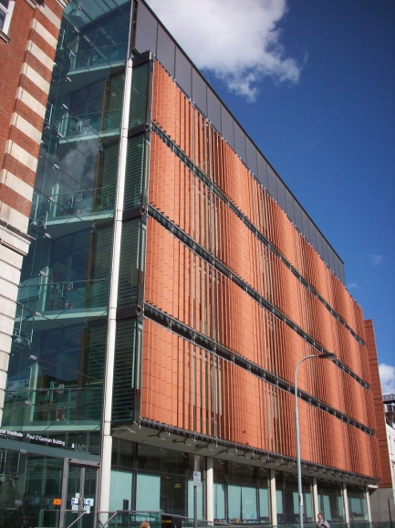
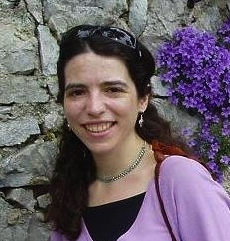
Acknowledgements
Andrew Teschendorff
Simone Severini
Lucas Lacasa
Ginestra Bianconi

