Slide 1
Inference and topological tracking of COMPUTER network TOPOLOGY from sparse time series*
A. Messager¹, I. Z. Kiss¹, R. Harper², P. Tee² and L. Berthouze¹
¹ Sussex University
² Moogsoft Ltd
*This work is supported by Moogsoft Inc. and describes patented features of its product.

Slide 2


Data Example
T = 1

Slide 3
Data Example
T = 2

Slide 4
Data Example
?
?
?
T = 3

Slide 5
Data Example
?
?
?
T = 4

Slide 6
Data Example
?
?
?
T = 5

Slide 7
Data Example
?
?
?
?
T = 6

Slide 8
Data Example
?
?
?
?
T = 7

Slide 9
Data Example
?
?
?
?
T = 8

Slide 10
Data Example
?
?
?
?
?
T = 9

Slide 11
Data Example
?
?
?
?
?
?
T = 10

Slide 12
Data Example
?
?
?
?
?
?
T = 11

Slide 13
Data Example
?
?
?
?
?
?
T = 12

Slide 14
Data Example
?
?
?
?
?
?
T = 13

Slide 15
Data Example
?
?
?
?
?
?
T = 14

Slide 16
Data Example
?
?
?
?
?
?
T = 15

Slide 17
Data Example
?
?
?
?
?
?
T = 16

Slide 18
Data Example
?
??
?
?
?
?
T = 17

Slide 19
Data Example
?
??
?
?
?
?
T = 18

Slide 20
Data Example
?
??
?
?
?
?
?
T = 19

Slide 21
Data Example
?
??
?
?
?
?
?
T = 20

Slide 22
Statement of the problem
Data:
  Sparse time-series (e.g. average of 100 alerts per node over 5 months)
Aim:
  Reconstruct topology
  Track functional topological changes
Note: Because we use the alerts time series, we can only detect functional link (opposed to structural ones)

Slide 23
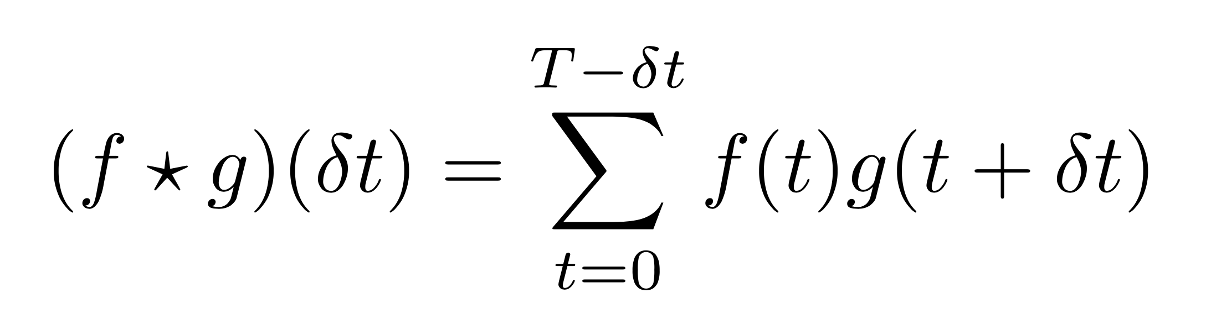
Cross-correlation
Main source of information is the delay between alerts. We compute the cross-correlation for each pair of nodes (f,g) defined onto [0;T]:

Slide 24
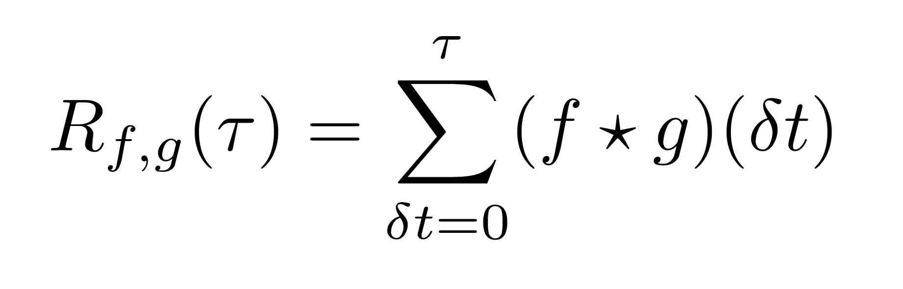
Intuition 1
1- The more peaks within the cross-correlation, the more likely the two nodes are connected
f and g two are times series defined onto [0;T]. We define the cumulated number of peaks:

Slide 25
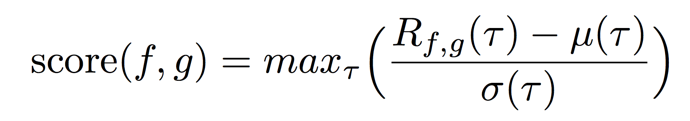
Intuition 2
2. The earlier the peaks within the cross- correlation (the smaller the delay between alerts), the more likely the two nodes are connected:
Average cumulated number of peaks
Z-score
Standard deviation of the cumulated number of peaks

Slide 26

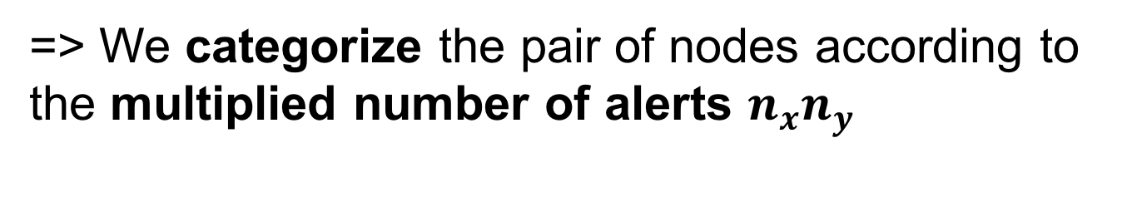
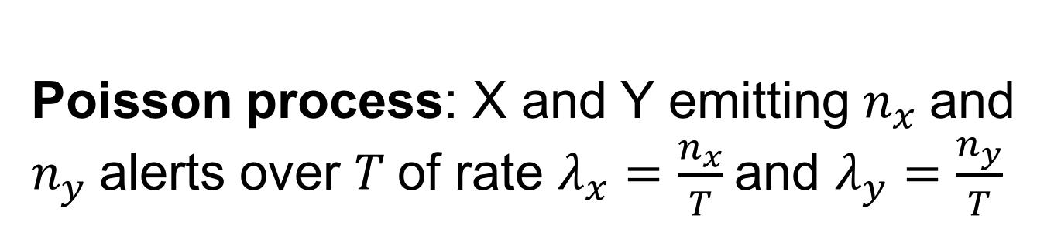
Intuition 3
3. We categorize the pairs of nodes according to the number of alerts they emit
Poisson process: X and Y emitting $n_{x}$and $n_{y}$alerts over $T$of rate $λ_{x}=\frac{n_{x}}{T}$and $λ_{y}=\frac{n_{y}}{T}$
$$𝔼\left(R_{XY}(τ)\right)=\frac{τ n_{x}n_{y}}{T^{2}}$$
=> We categorize the pair of nodes according to the multiplied number of alerts $n_{x}n_{y}$

Slide 27
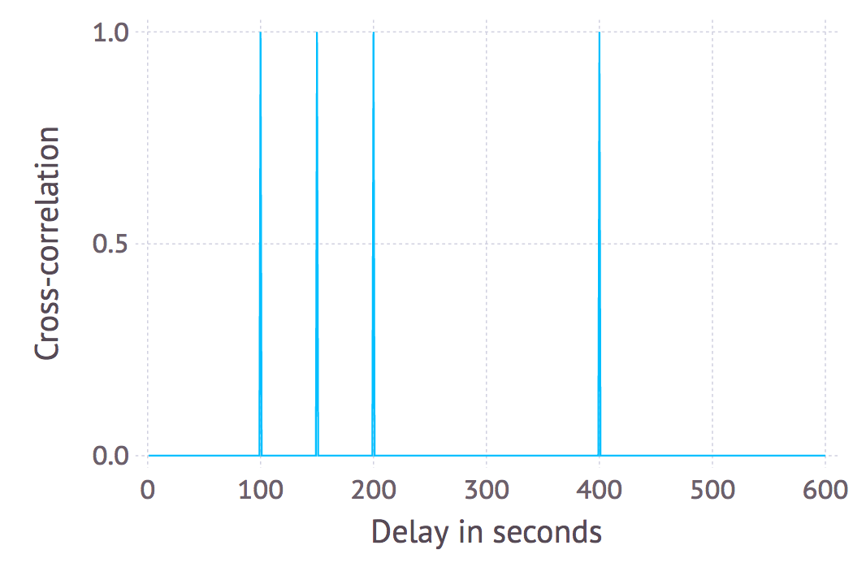
Example
1. Computation of the cross-correlation (peaks at delay: 100s, 150s, 200s and 400s)

Slide 28
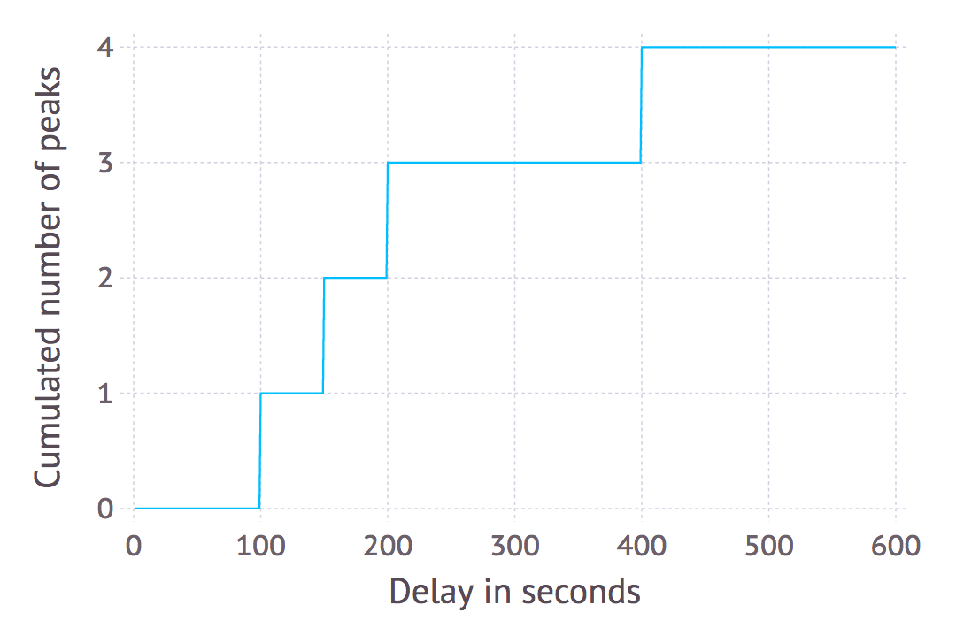
Example
2. Computation of the cumulated number of peaks:

Slide 29
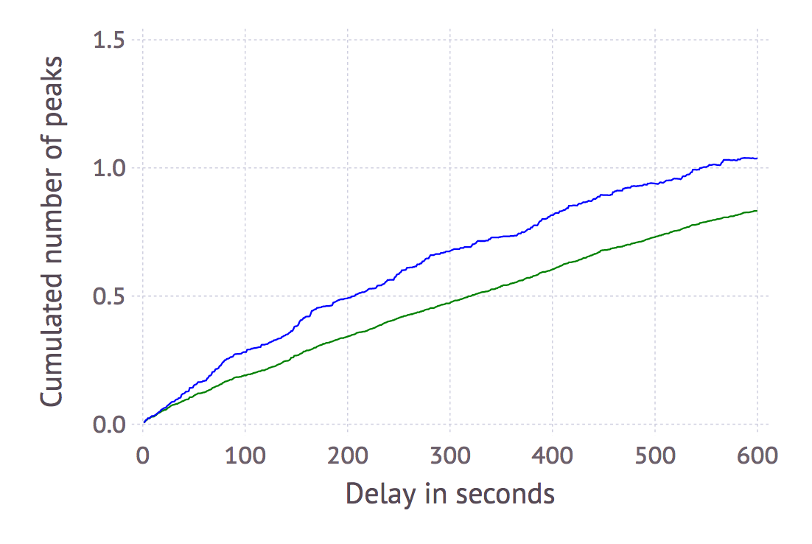
Example
3. Computation of the average and of the standard deviation of the cumulated number of peaks
Standard deviation
Average

Slide 30
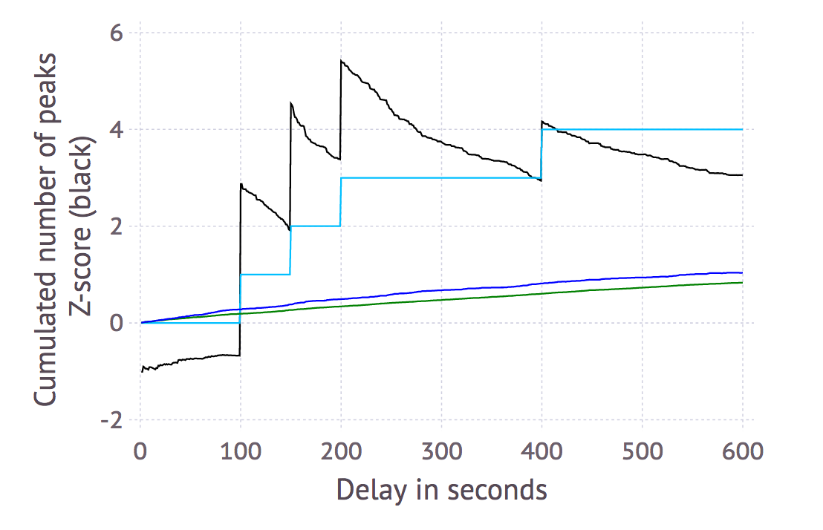
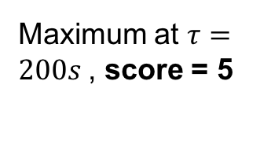
Example
4. Computation of the Z-score and extraction of the score
Maximum at $τ=200s$, score = 5
Cumulated number of peaks
Z-score
Standard deviation
Average

Slide 31
Problem Formulation
How to get the topology from the scores? How to track the topological changes?
Solution:
  We divide the signal into window
  We compute a score s(t_{w}) on each window
  We translate the past scores to edges probabilities p_{e}(t_{w})

Slide 32
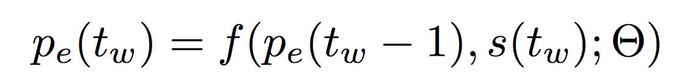
Edge probabilities
S(t_{w}–1)
S(t_{w})
S(t_{w}+1)
p_{e}(t_{w}–1)
p_{e}(t_{w})
p_{e}(t_{w}+1)
Time

Slide 33
Sparsity problem
The main problem is the sparsity. There are very often no alerts between pair of nodes.
Presence of Information: An inference can be made if and only if both nodes of the pair emit an alert during the time window considered

Slide 34
Edge probabilities
Three cases:
High score and information => we increase the edge probability
Low score and no information => we decrease the edge probability
No information => we do nothing
Warning:
The more time goes by, the less valuable our information is => introduction of a decay

Slide 35
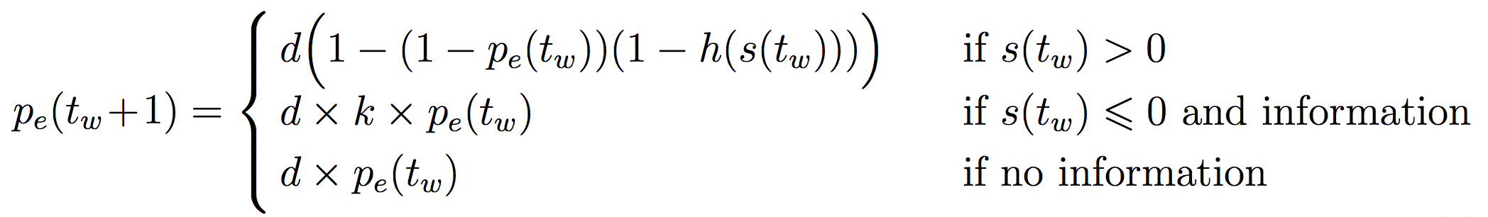
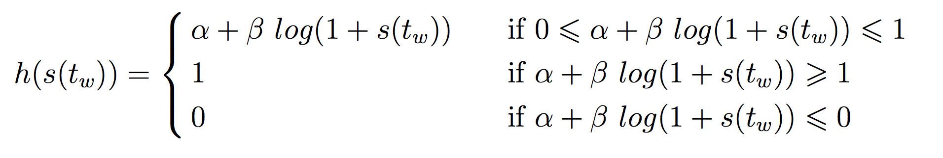
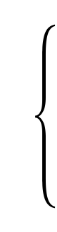




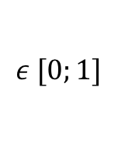
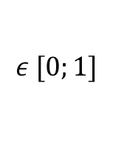
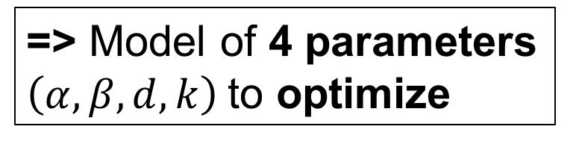

Edge probabilities Model
$$ε ℝ$$
(slope intercept parameter)
=> Model of 4 parameters $\left(α,β,d,k\right)$to optimize
$$ε ℝ$$
(slope parameter)
$$ε [0;1]$$
(decreasing parameter)
$$ε [0;1]$$
(decay parameter)

Slide 36
Edge probabilities
S(t_{w}–1)
S(t_{w})
S(t_{w}+1)
prediction
prediction
p_{e}(t_{w}–1)
p_{e}(t_{w})
p_{e}(t_{w}+1)
Time

Slide 37
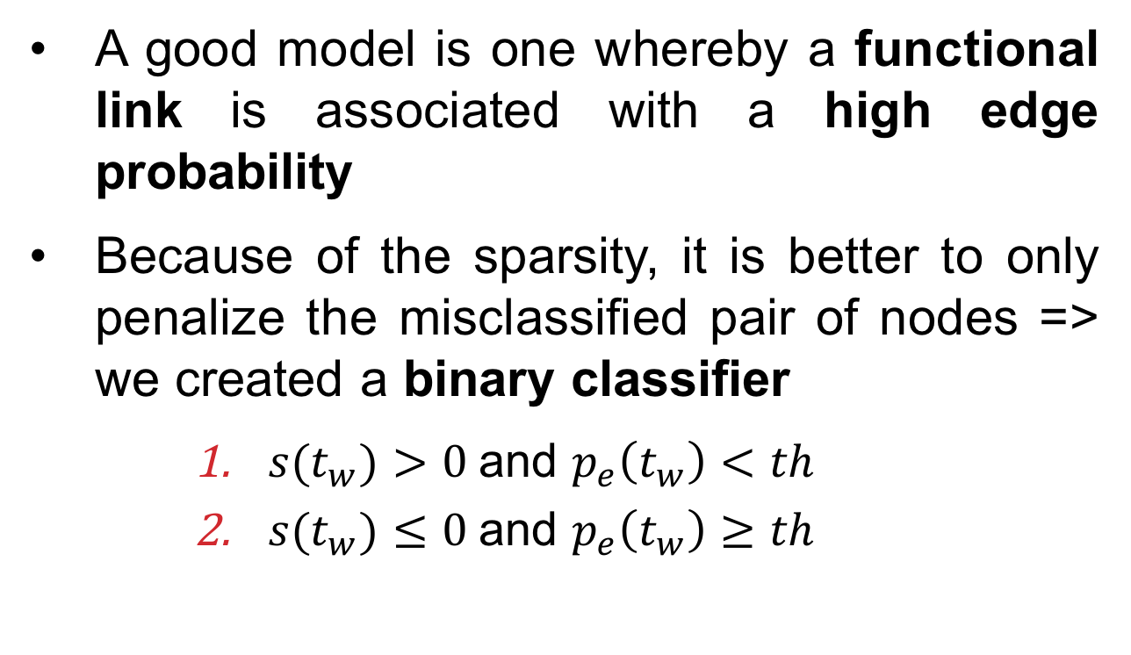
Error Function
A good model is one whereby a functional link is associated with a high edge probability
Because of the sparsity, it is better to only penalize the misclassified pair of nodes => we created a binary classifier
    ${s(t}_{w})>0$and $p_{e}\left(t_{w}\right)<th$
    ${s(t}_{w})≤0$and $p_{e}\left(t_{w}\right)≥th$

Slide 38
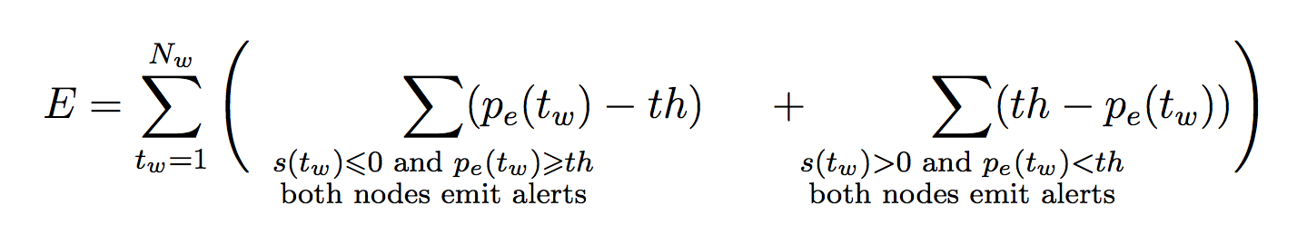
Error Function
If the score is low we expect a low edge probability
If the score is high we expect a high edge probability
We minimize the error using gradient descent and take the resulting parameters.

Slide 39
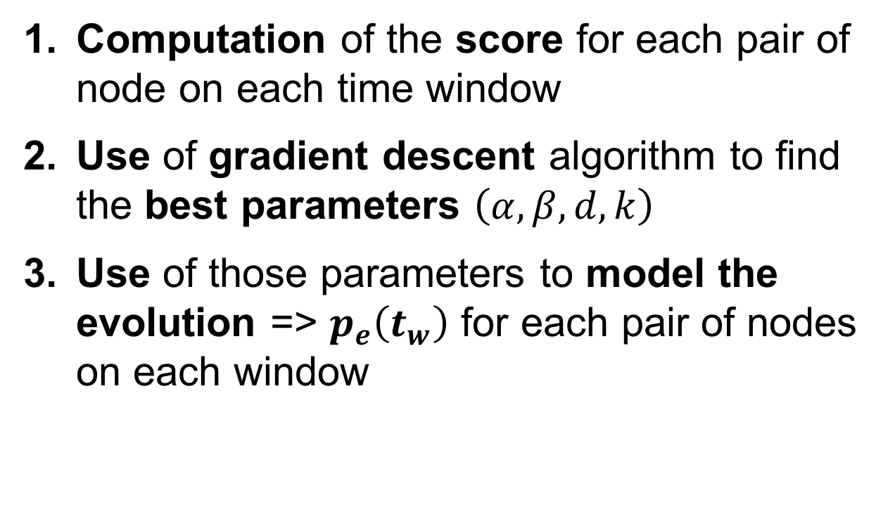
Summary
Computation of the score for each pair of node on each time window
Use of gradient descent algorithm to find the best parameters $\left(α,β,d,k\right)$
Use of those parameters to model the evolution => $p_{e}\left(t_{w}\right)$ for each pair of nodes on each window

Slide 40
How to validate the method?
We detect functional links. Several validations method:
Predict the future
Analyze the prediction of functional links
=> Easier to create a network where functional links are structural link

Slide 41
Synthetic Data
We created synthetic data where problems occur on edges and make their extremity nodes emit alerts in quick succession.
It depends mainly on two parameters:
  The number of alerts
  The rate of change of the topology

Slide 42
Synthetic Data Example

Slide 43
Synthetic Data Example

Slide 44
Synthetic Data Example

Slide 45
Synthetic Data Example

Slide 46
Synthetic Data Example

Slide 47
Synthetic Data Example

Slide 48
Synthetic Data Example

Slide 49
Synthetic Data Example

Slide 50
Synthetic Data Example

Slide 51
Synthetic Data Example

Slide 52
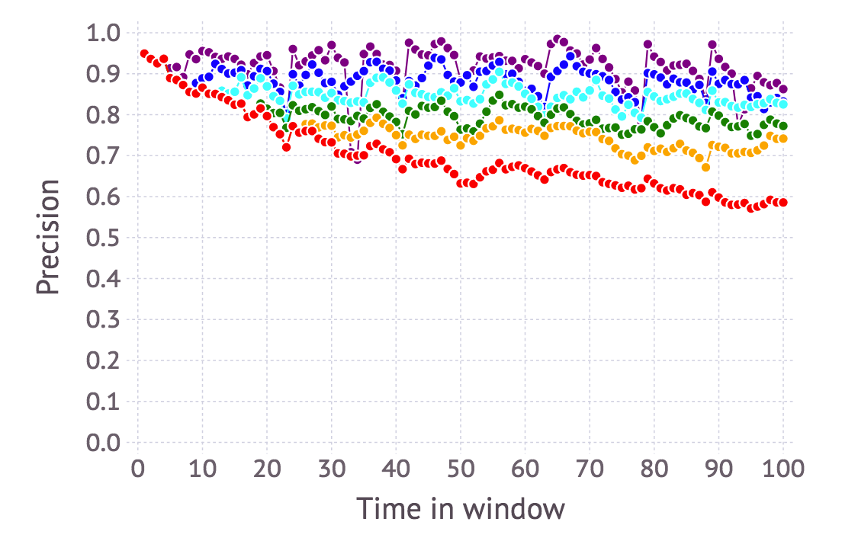
Precision
Precision: Percentage of edges correctly predicted over the number of the predicted ones.
Minimal edge probability above which an edge is predicted (p_{e} > th)
th = 0.7
th = 0.5
th = 0.35
th = 0.2
th = 0.1
th = 0.01
The precision increases with the edge probability threshold

Slide 53
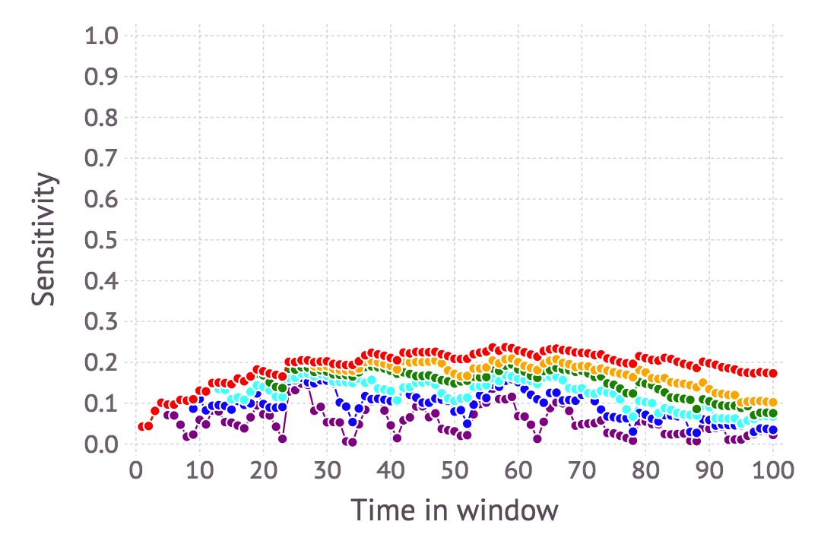
Sensitivity
Sensitivity: Percentage of edges correctly predicted over the number of actual edges
Minimal edge probability above which an edge is kept (p_{e} > th):
th = 0.7
th = 0.5
th = 0.35
th = 0.2
th = 0.1
th = 0.01
The sensitivity decreases with the edge probability threshold

Slide 54
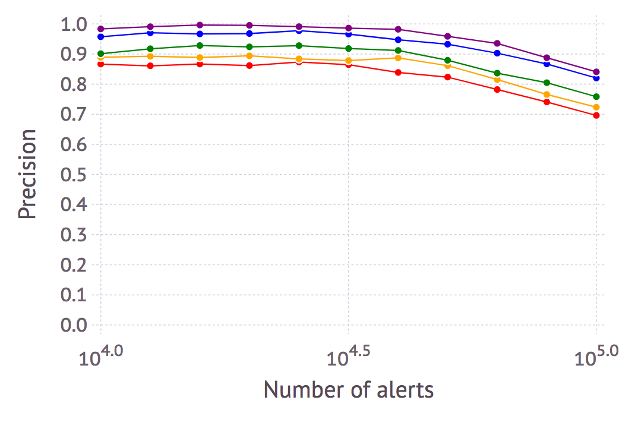
Precision
Percentage of edges changed:
c = 0%
c = 10%
c = 40%
c = 70%
c = 100%
Precision slightly decreases with the rate of change of the topology and the number of alerts

Slide 55
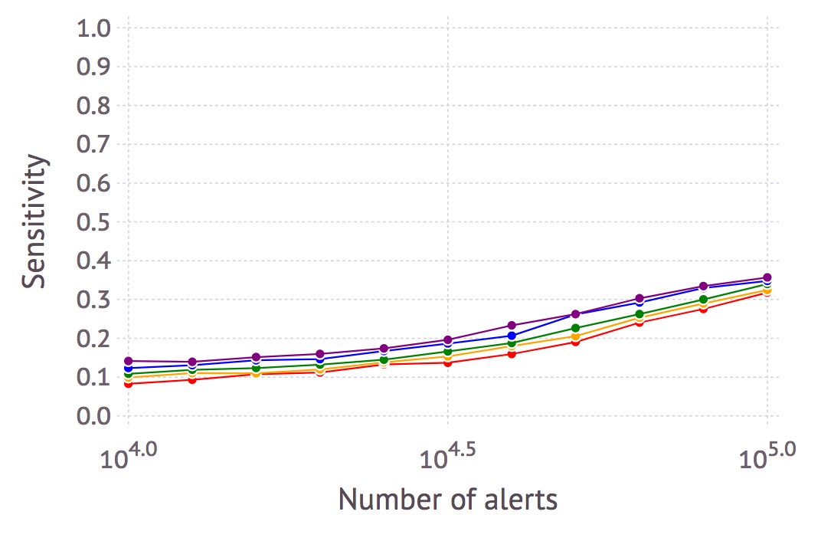
Sensitivity
Percentage of edges changed:
c = 0%
c = 10%
c = 40%
c = 70%
c = 100%
Sensitivity increases with the number of alerts

Slide 56
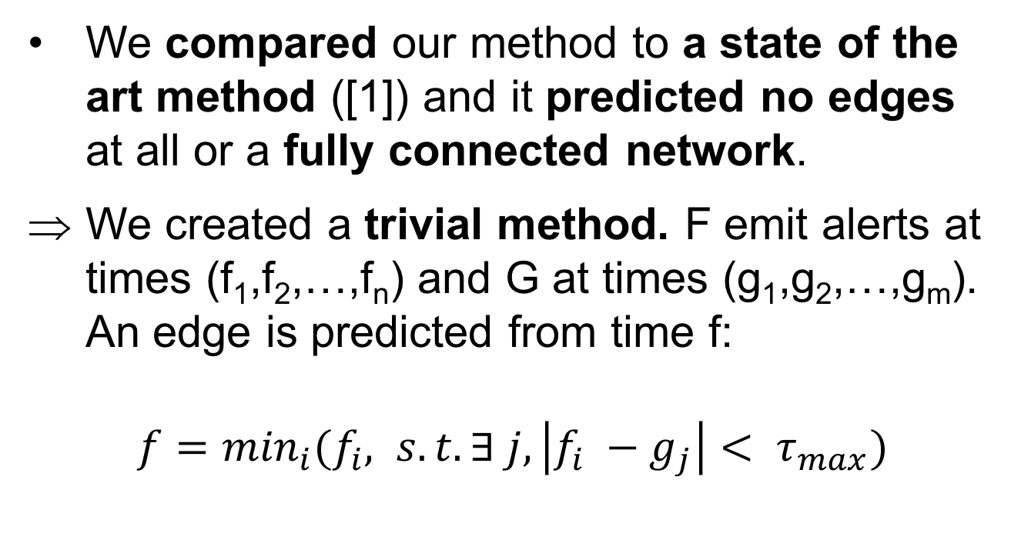
Benchmarking
We compared our method to a state of the art method ([1]) and it predicted no edges at all or a fully connected network.
We created a trivial method. F emit alerts at times (f₁,f₂,…,f_{n}) and G at times (g₁,g₂,…,g_{m}). An edge is predicted from time f:
$f=\min_{i}⁡(f_{i}, s. t. ∃ j, \left|f_{i} −g_{j}\right|< τ_{max})$
[1] David Hallac, Youngsuk Park, Stephen Boyd, and Jure Leskovec. Network inference via the time-varying graphical lasso. arXiv preprint arXiv:1703.01958, 2017.

Slide 57
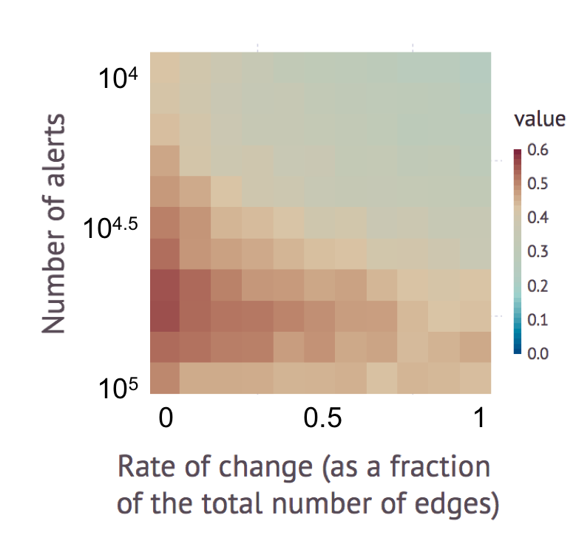
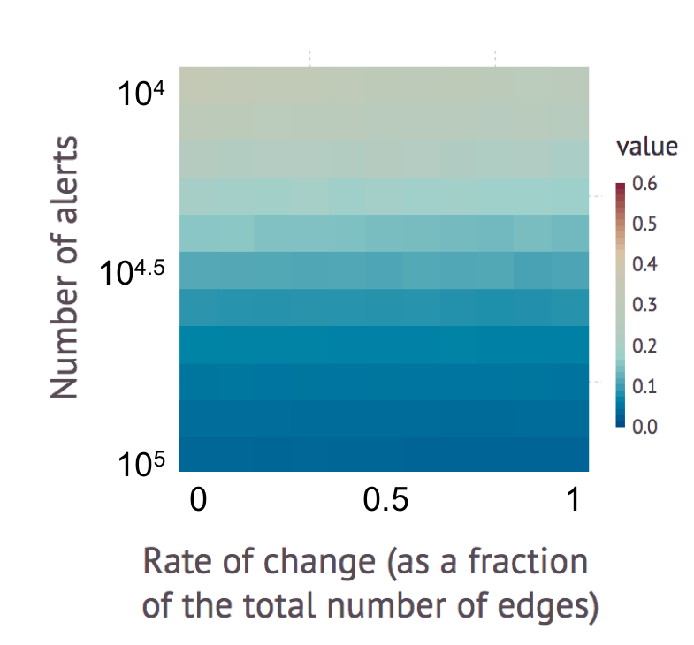
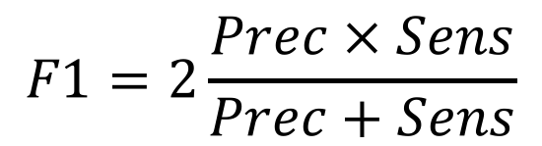
Performance comparison
$$F1=2\frac{Prec × Sens}{Prec+Sens}$$
Our method
Trivial method

Slide 58
Real Data
Internet Service Provider network
10,984 nodes emit alerts and are within the giant component, 117,486 edges
Topology measured at the end of the recording => ground truth

Slide 59
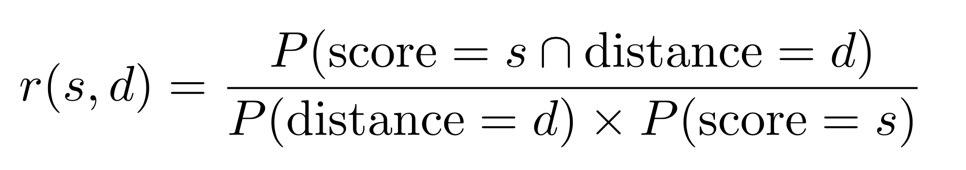
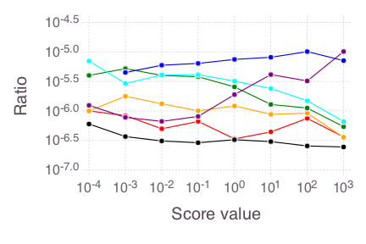
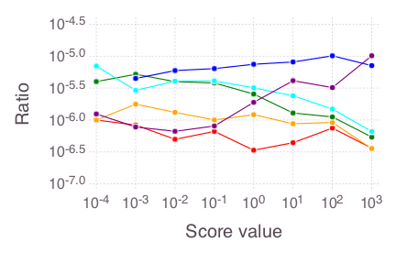
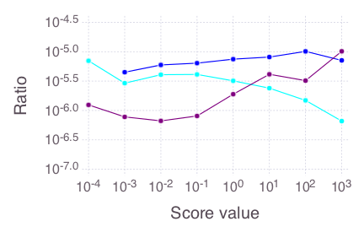
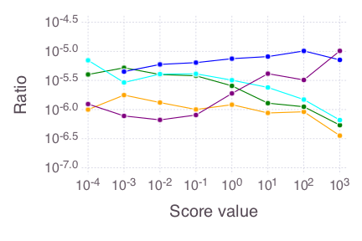
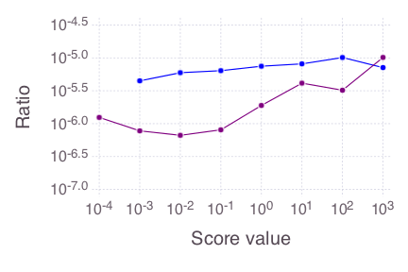
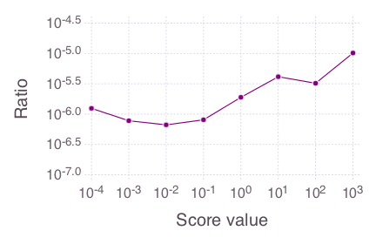
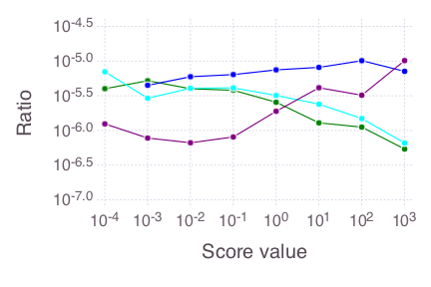
What does the score tell us?
d = 1
d = 2
d = 4
d = 6
d = 8
d = 10
all other distances

Slide 60
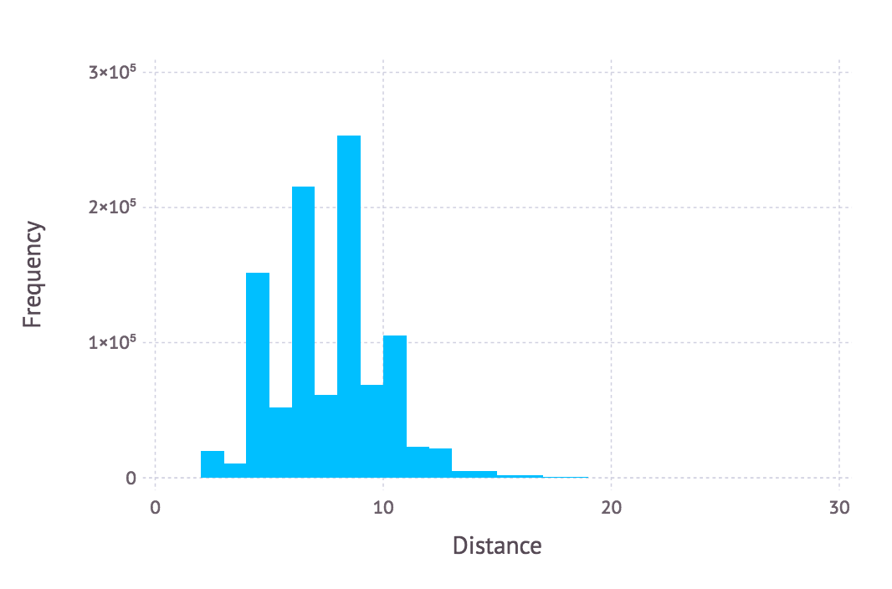
What does the score tell us?
3x10⁵
2x10⁵
Frequency
1x10⁵
0
0
10
20
30
Distance
Histogram of the pairwise distance between nodes within the real data
There are 60 times more pairs at distance 2 than at distance 1

Slide 61
What does the score tell us?
d = 1
d = 2
d = 4
d = 6
d = 8
d = 10
all other distances
Alerts are caused by dysfunctional nodes that don’t emit alert

Slide 62
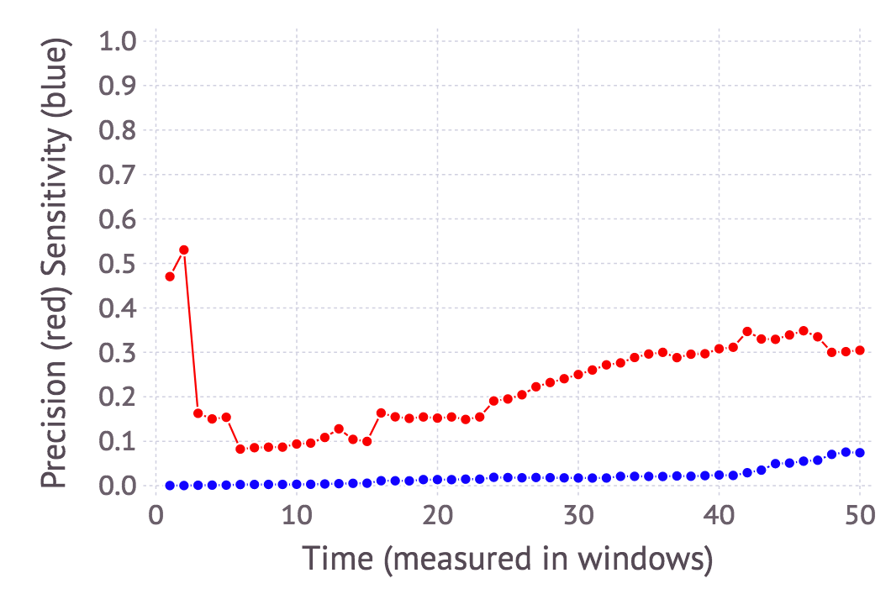

Real Data (snapshot of the network taken at the end of the recording)
Ground truth: pair of nodes at distance 2
precision
sensitivity
615,000 detected pairs of nodes (~33% precision) => 205,000 correctly detected pairs
117,000 distance 1 edges in the real topology

Slide 63

Summary
Track the changes in the topology
Best method so far
Poor sensitivity in general
Poor precision on the real data
Enable dynamic behavior of the parameters

Slide 64
Thank YOU!
Questions?

