Slide 1
Understanding User Contention and Its Effects on Resource Allocation in Heterogeneous Networks
Dr Glenford Mapp
Associate Professor
Head of the C-ITS Research Group
Middlesex University, London

Slide 2
Outline of this talk
Motivation for this research
Look at contention-based networks
Heterogeneous networking in highly mobile environments
Proactive resource allocation using contention analysis
Application to VANET networks
Questions

Slide 3
Motivation
Users are demanding more of common networks by running applications that need Quality of Service support
New networks being deployed: 5G, 802.11p, tactile networks
Leading to heterogeneous networking
Devices will have several network interfaces

Slide 4
New Algorithms for new scenario
In the old world, a device was attached to only one network, so the concern was how the network would respond when a lot of users were using this one network
New heterogeneous networking environment : If one network is saturated, then devices can hand over to other networks
Learning to manage several networks at the same time. Optimizing overall network perfrmance
Need to understand how different networks are performing in response to user demand

Slide 5
Deeper understanding of user contention
Contention is the competition for network resources based on user demand
It can be used to indicate how well a network can perform as user demand increases
Find the parameters for optimal performance
Contention-based networks
Pure ALOHA, Slotted ALOHA, etc.
Server-based systems
Queueing Theory

Slide 6
Contention-based Networks
Users directly contend to use the network. So we either have a successful transmission or a collision
We need to find P _{success}: the probability of a successful transmission
The throughput, Th = λP _{success}
We need to understand how user demand affects the throughput, Th

Slide 7
Analysis Parameters
There are N nodes in the network.
Each node acts completely independently of other nodes.
Packets to be transmitted are generated at average rate, λ
Packet arrival is a Poisson Process, i.e., the inter-arrival time is exponentially distributed
Each packet is transmitted in time T

Slide 8
Pure ALOHA Protocol
A node transmits when a packet is generated.
If the node receives an ACK, then the packet was received OK
If no ACK, then a collision has occurred and the packet is retransmitted after a random back-off period
This analysis does not consider back-off

Slide 9
Pure ALOHA
0
T
2T
t->
Successful transmission of a packet by a node at time T is given by:
P(node transmits at time T) &&
P (no other node transmits between 0 and 2T)
P(Success) = λe^{-λT} e^{-λ2(N-1)T} = λe^{-λ(2N-1)T} P(Success) _{max} = dP(Success)/dλ = 0
Solution: λ = 1/(2N-1)T P(Success) _{max} for N nodes = N/(2N-1) T e ⁻¹
As N -> ∞, P(Success) _{max} ~ ½ e⁻¹

Slide 10
Pure ALOHA
Throughput = Th = λP(Success) = λ² e ^{–λ(2N – 1)T}
Th _{max} = dT/dλ = 0
Solution λ = 2/(2N-1)T
For N nodes: Th _{max} = 4N/((2N-1)T)² e⁻²
As N-> ∞, Th _{max} ~ (1/N) e⁻²

Slide 11
Slotted ALOHA Protocol
All nodes on the network are synchronized using a global clock
Nodes can only transmit at predefined epochs usually at T, 2T, etc.
A node having a packet to send must wait until the next epoch at which time the packet is transmitted.
If no ACK, then a collision has occurred and the packet is retransmitted after a random back-off period

Slide 12
Slotted ALOHA
0
T
2T
t->
Successful transmission of a packet by a node at time T is given by:
P(node has a packet to transmit between 0 and T) &&
P (no other node has a packet to transmit between 0 and T)
P(Success) = (1 – e-^{λT}) e^{-λ(N-1)T} P(Success) _{max} = dP(Success)/dλ = 0
Solution: e^{-λT} = (N-1)/N P(Success) _{max} for N nodes = ((N-1)/N)^{N-1}
As N -> ∞, P(Success) _{max} ~ e⁻¹

Slide 13
Slotted ALOHA
Throughput = T = λP(Success) = λ (1 – e^{-λT}) e ^{–λ(N-1)T}
Th _{max} = dT/dλ = 0
Solution e^{-λT} = [ 1 – (λT/NλT -1) ] Solution = λ_{N} for a given value of N
For N nodes: Th _{max} = (Nλ_{N}²T / (Nλ_{N}T – 1) [ 1 – (λ_{N}T/Nλ_{N}T -1) ] ^{N-1}
As N->∞, Th _{max} ~ λ_{N}e⁻¹
As N->∞, λ _{N} ~ 0

Slide 14
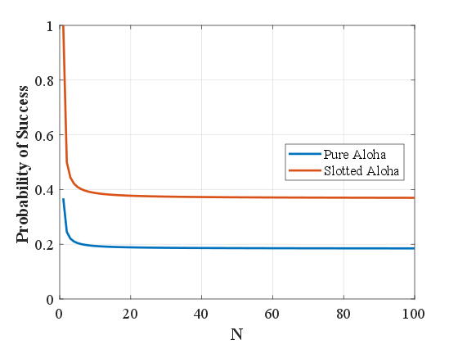
P _{success} for Pure and Slotted ALOHA

Slide 15
Benefits of this Approach
Examined the nature of contention in detail
Able to express such contention using probabilistic equations
Able to see the effect of loading the network
Can we apply this to other networks than just contention-based networks

Slide 16
Mobile Networks

Slide 17
Mobile Networks
We first define two circles represented by:
Handover Radius: represents the communication between the base-station and the Mobile Node. Beyond this region, signals may not be detected.
Exit Radius: For seamless handover, handover must begin at the Exit Radius so that handover is completed by the time the MN reaches the Handover Radius

Slide 18
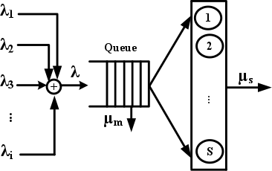
Mobile Networks – Classical Model

Slide 19
Mobile Network Analysis
A Mobile Node (MN) can leave the system because:
the MN uses the data channel and so is served
The MN leaves the system due to mobility while being served
The MN leaves the system due to mobility with no service
If we can detect the final case early; then we can signal to the MN that it is unlikely to get service in this network
In a heterogeneous environment, the MN can also be immediately signaled to go to another network.
There is no waiting for a channel that the MN is not likely to ever get

Slide 20
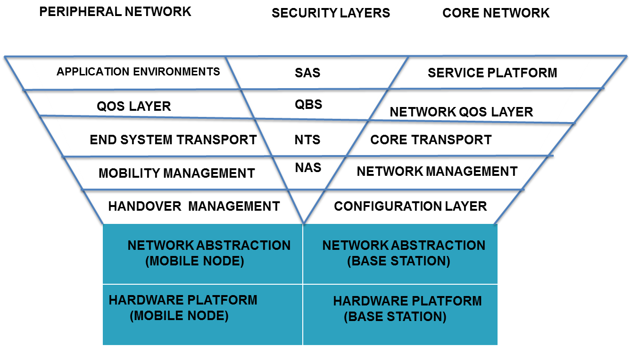
Building Future Networks (Y-Comm)

Slide 21
Y-Comm
Seeks to provide mechanisms to build future networks
Solution: Integrate communications, mobility, QoS and security
Key Concepts:
Time Before Vertical Handover (TBVH)
Network Dwell Time (NDT)
Y-Comm also showed how TBVH and NDT can be calculated for any arbitrary network setup

Slide 22
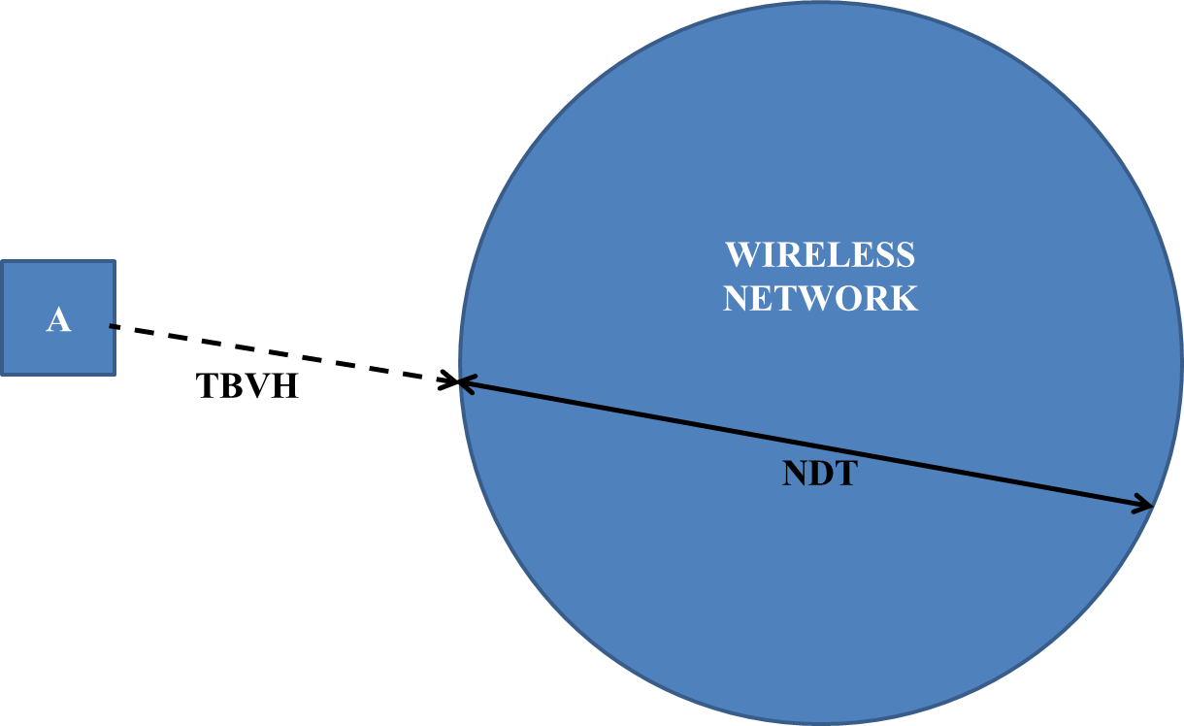
TBVH and NDT

Slide 23
Requests for Resources
WIRELESS
NETWORK
REQ (Time , TBVH, NDT)
A
A
B
REQ (Time , TBVH, NDT)
B

Slide 24
Contention Analysis
MN_{A} needs channel at (Time + TBVH) _{A}
MN_{A} releases channel at (Time + TBVH + NDT)_{A}
MN_{B} needs channel at (Time + TBVH)_{B}
MN_{B} releases channel at (Time + TBVH + NDT)_{B}

Slide 25
There are 3 outcomes
No contention:
(Time + TBVH)_{A} < (Time + TBVH)_{B}
(Time + TBVH + NDT)_{A} < (Time + TBVH)_{B}
Contention: Two Types: Partial and Total
(Time + TBVH)_{A} < (Time + TBVH)_{B}
(Time + TBVH + NDT)_{A} > (Time + TBVH)_{B}
Partial Contention:
Total Contention:
(Time + TBVH + NDT)_{A} < (Time + TBVH + NDT)_{B}
(Time + TBVH + NDT)_{A} >= (Time + TBVH + NDT)_{B}

Slide 26
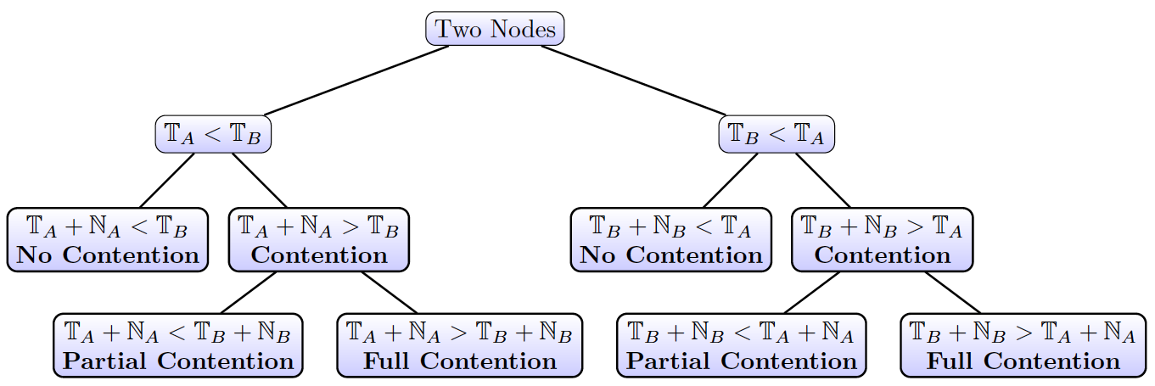
Contention Analysis for 2 Nodes

Slide 27
Request Summary
No Contention: Requests granted as requested:
Channel granted at (Time + TVBH)_{A}
Channel released at (Time + TBVH + NDT)_{A}
Same with B
Partial Contention: Requests granted but modified for B
Channel granted at (Time + TBVH + NDT)_{A}
Channel released at (Time + TBVH + NDT)_{B}
Full Contention: Request for B not granted:
Force B to handover to another network

Slide 28
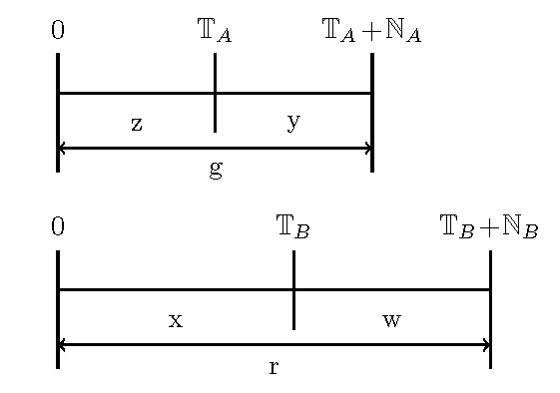
Analysis of Contention
P(Z=z) where Z is an exponential random variable of T_{A} with mean: τ_{A}
P(Y=y) where Y is an exponential random variable of N_{A} with mean: η_{A}
P(X=x) where X is an exponential random variable of T_{B} with mean: τ_{B}
P(W=w) where W is an exponential random variable of N_{B} with mean: η_{B}
No contention: z < x, g < x
Partial Contention: z < x, g > x, g < r
Full Contention: z < x, g > x, g > r

Slide 29
Results
No contention = τ_{A} η_{A}
(τ_{A} + τ_{B} )(η_{A} + τ_{B} )
Partial Contention = τ_{A} τ_{B} η_{A}
(τ_{A} + τ_{B} )(η_{A} + τ_{B} ) (η_{A} + η_{B})
Full Contention = τ_{A} τ_{B} η_{B}
(τ_{A} + τ_{B} )(η_{A} + τ_{B} ) (η_{A} + η_{B})

Slide 30
Results verified using an independent Discrete Event Simulation; Node A – (50,10)
No contention

Slide 31
Partial Contention:
Full Contention:

Slide 32
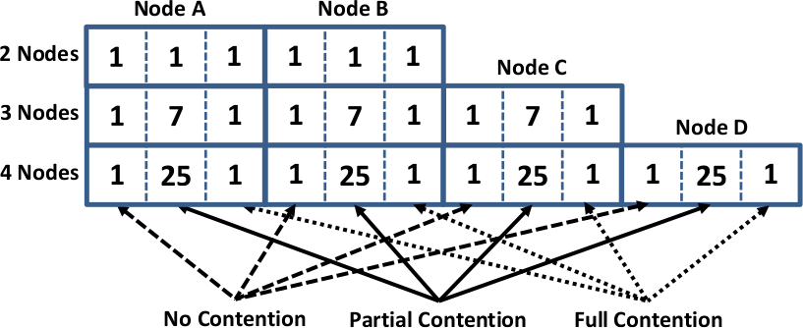
Further work
Also analyzed 3-node scenario:
General observations
For N nodes:
possible outcomes: is
3 ^{N-1} N
General Formula for No contention

Slide 33
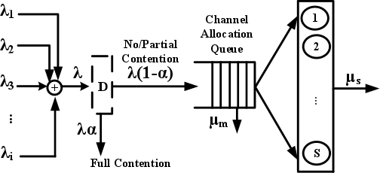
First Model: Decision Model
Check for full contention as requests arrive. Nodes that would experience full contention are not allowed to join the channel queue:

Slide 34
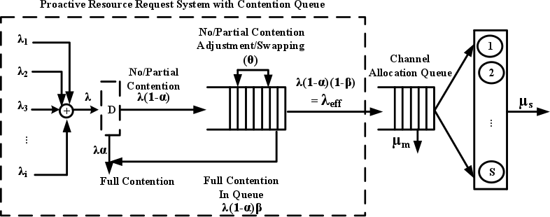
Second Model: Decision plus Contention queue
We introduce a queue called a contention queue into which requests for the channel are placed before the channel queue.

Slide 35
Second Model
The effective rate into the channel queue is:
λ _{ef f} = λ (1 − α) * (1 – β)
New Queuing Model is:

Slide 36
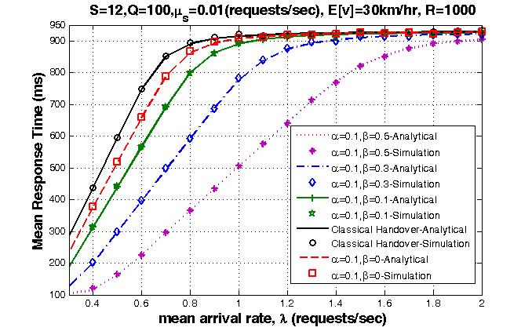
Results from Simulation and Analytical Models-MRT

Slide 37
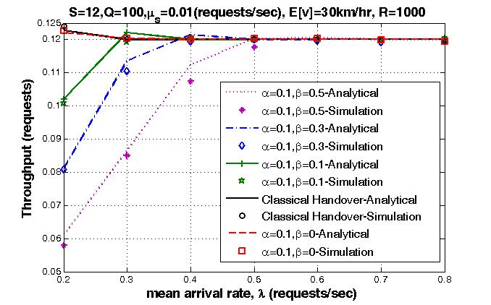
Results from Simulation and Analytical Model- Throughput

Slide 38
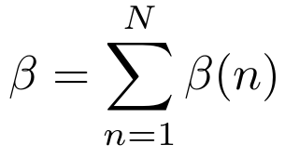
Calculating α and β
α is calculated using the full contention model
β is calculated by comparing each entry in the queue with an incoming request.
For the n^{th} entry in the queue, the P( that the incoming request or the n^{th} entry is ejected from the queue) is given by:
β is the sum of β(n) over all the entries in the queue:

Slide 39
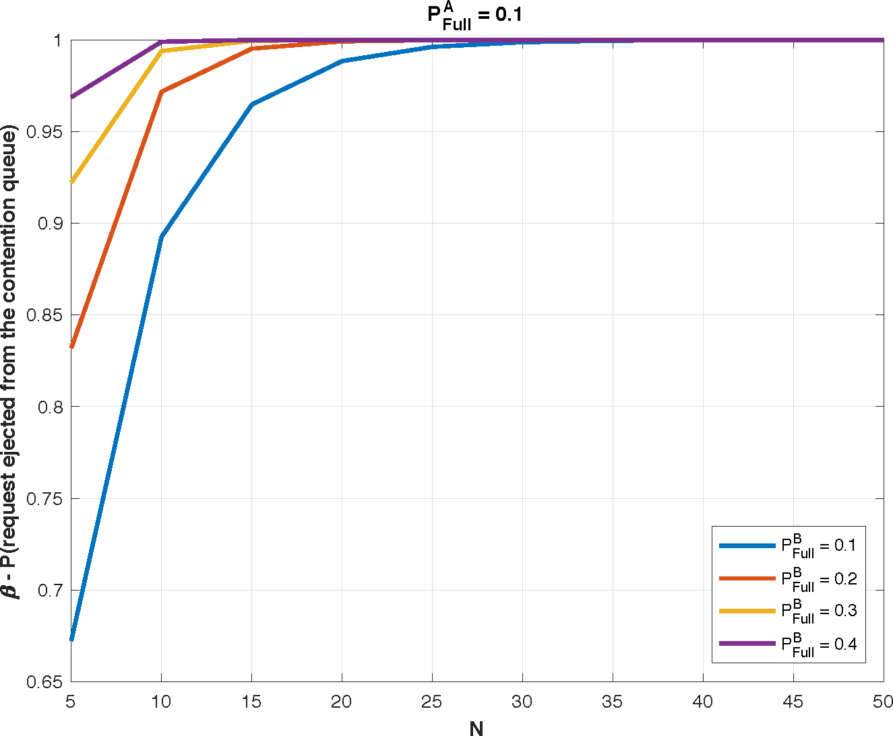
Graph of Results for β

Slide 40
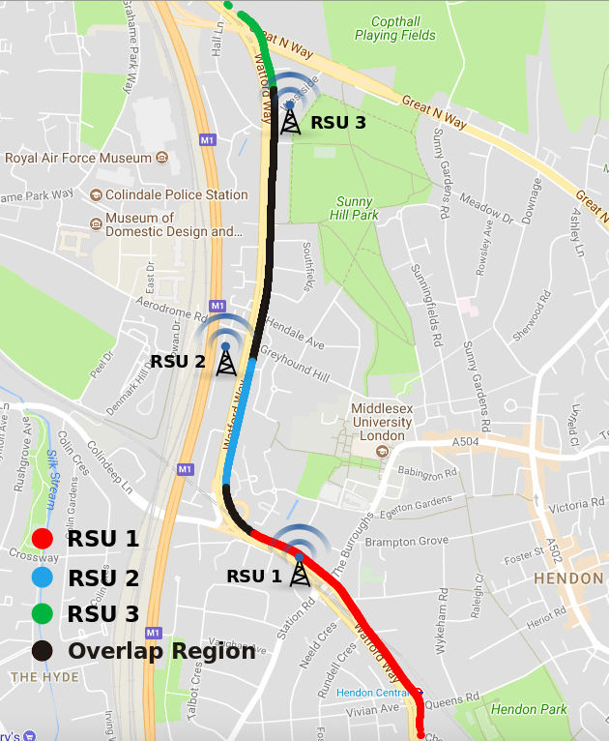
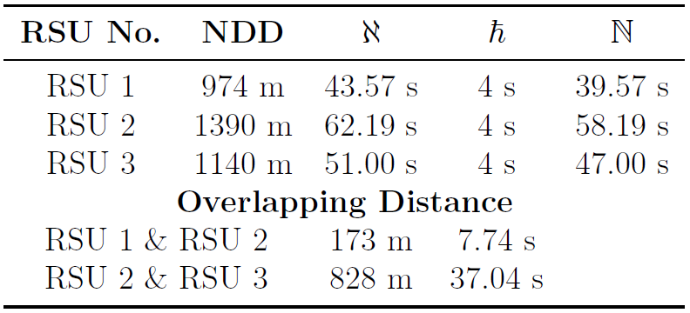
Application of results using the MDX VANET Testbed

Slide 41
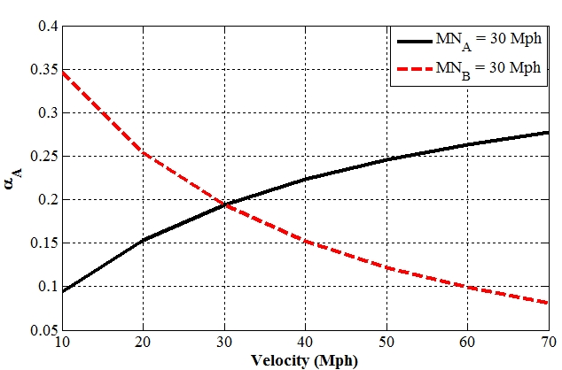
Calculating α for varying speeds

Slide 42
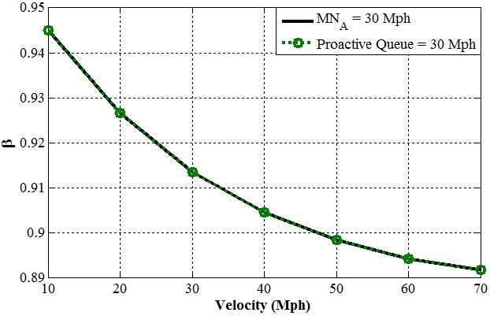
Calculating β for varying speeds

Slide 43
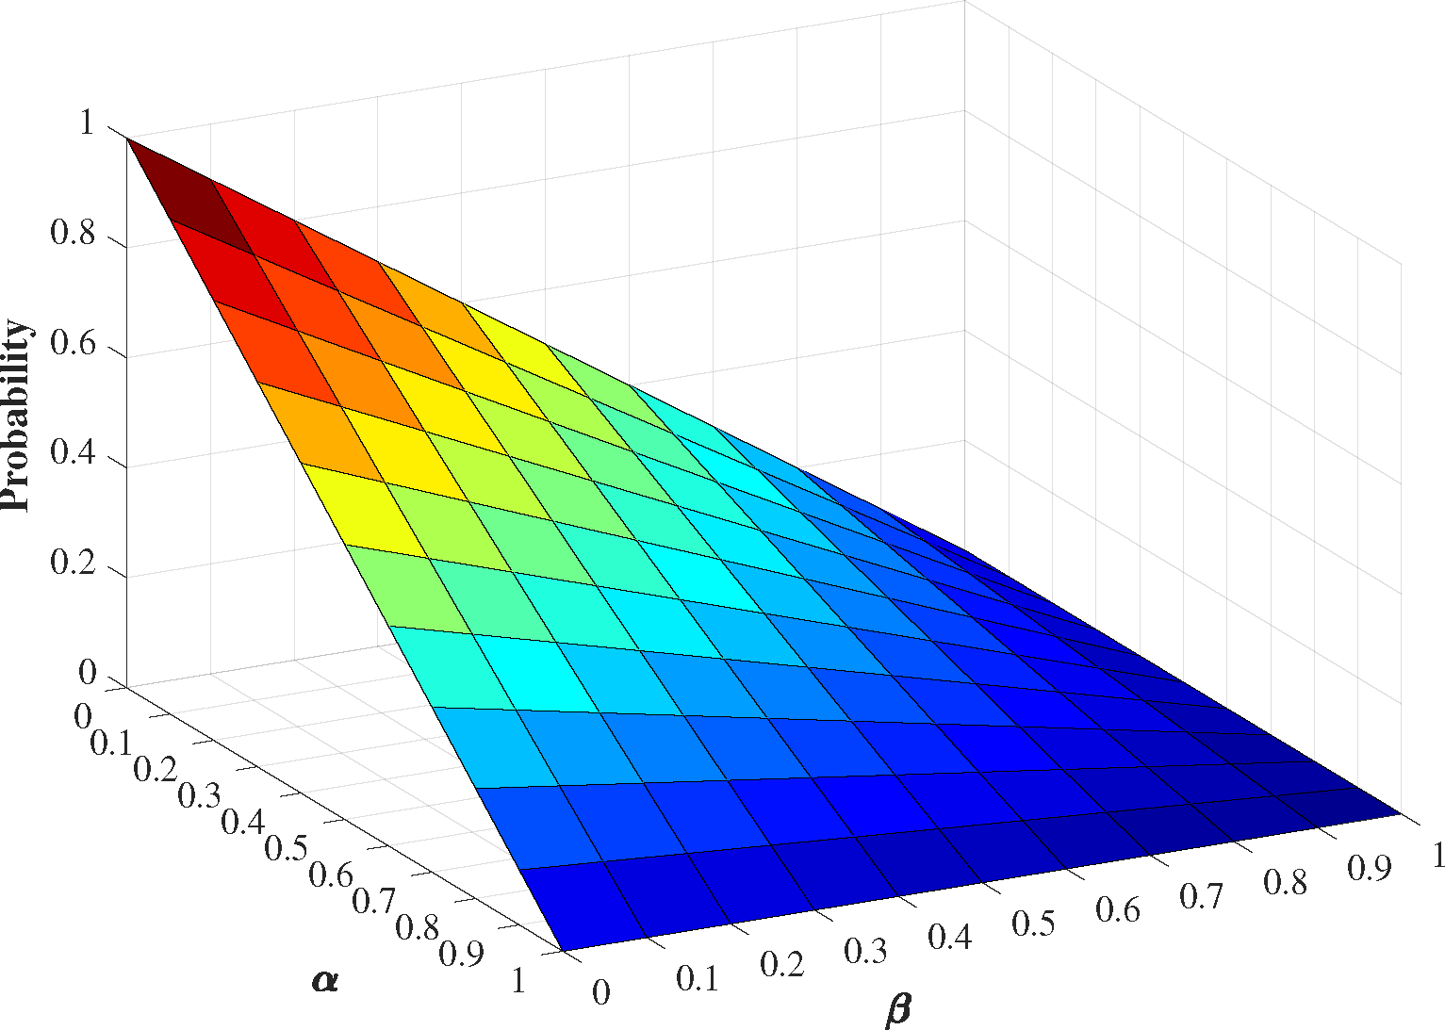
Future Work: Operational Space

Slide 44
THANK YOU FOR LISTENING
QUESTIONS?

