Slide 1







Consume Local
Towards Carbon-free Content Delivery
Aravindh Raman‡, Dmytro Karamshuk‡, Nishanth Sastry‡,
Andrew Secker†, Jigna Chandaria†
‡ King’s College London, UK
† BBC R&D, London, UK
Notes:
Buy Local– users like to buy local
– consume local – Netflix
Rethink buy local
example. Enabling Carbon free content delivery through peer-assisted content delivery
In collab. with BBC. BBC decrease the carbon-footprint
take through Peer-assisted content delivery

Slide 2



Peer-assisted Content Delivery
How many peers close-by?
ExP
Edge devices are energy-expensive
PoP
Internet
Core Router
Notes:
Traditional deliver => Server -> to the user
What peer-assistance enables
How close the user are and how popular the content is. Niche interest
Core-router would be few kw, ExP per user energy foot print – differential cost could be high
How traditional way could be better.
Each hop is expensive – per user cost is expensive

Slide 3
Research Questions?
Does P2P content sharing save energy? – YES!!
  Model energy savings from P2P
  Evaluate the savings using real time data access
How can users be incentivized for sharing the content? – CCT!!
  Through Carbon Credit Transfers (CCT)
  CCT makes users carbon positive
Notes:
Does P2P content save energy?
What’s the benefit to the users.
Carbon-Offset
Will start with modelling

Slide 4

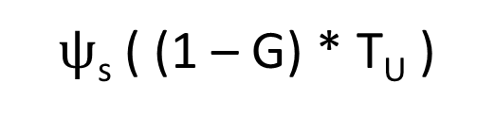

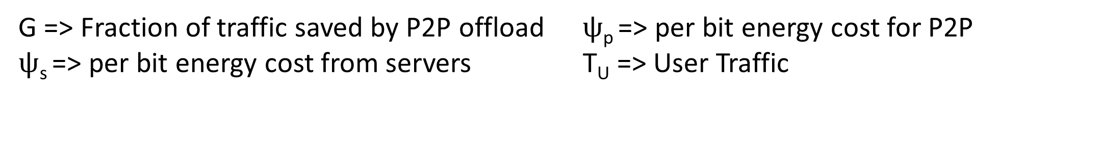
Modelling
Energy consumed = Energy consumed by user traffic thru’ (traditional CDN + peer-assisted)
G => Fraction of traffic saved by P2P offload
$ψ$_{s} => per bit energy cost from servers
$ψ$_{p} => per bit energy cost for P2P
T_{U} => User Traffic
$ψ$_{s} ( (1 – G) * T_{U} )
$ψ$_{p} ( G * T_{U} )
+
Energy Savings (S) = 1 –
$ψ$_{s} ( T_{U} )
Notes:
We calculate the energy consumed per bit – fraction of traffic saved
Calculation of $ψ$_{s} is Straightforward.
G and talk about the capacity – the more the user the close-by you save the energy
Closed-form solution

Slide 5





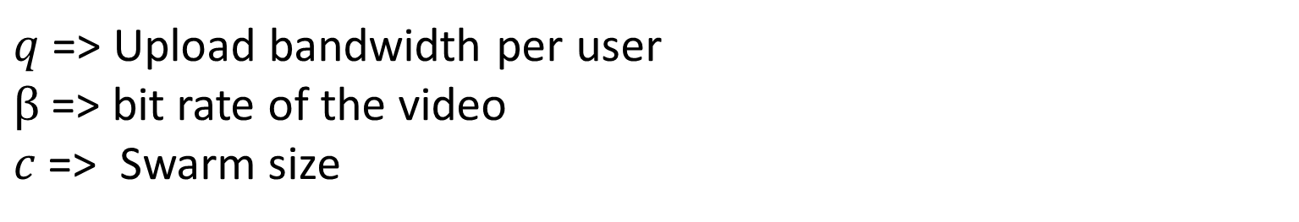

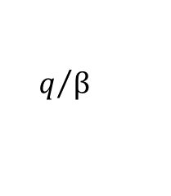

Energy Savings Formulation
$\frac{ q(c + e^{−c} − 1)(ψ\text{s}− ψm)}{βcψ\text{s}}−\frac{ q X PUE }{βcψ\text{s} }$ X
S =
$$[ \left(ϒ\text{P}\text{o}\text{P}−ϒ\text{E}\text{x}\text{P}\right)f\left(\text{p}\text{E}\text{x}\text{P} ,c\right)+\left(ϒ\text{core}−ϒ\text{P}\text{o}\text{P}\right)f\left(\text{p}\text{PoP},c\right)$$
$$+\left(ϒ\text{core}\right)f\left(\text{p}\text{core} ,c\right)]$$
$$q/β$$
$$1.0$$
$$0.8$$
Energy Savings (S)
$$0.6$$
$$0.4$$
$q$ => Upload bandwidth per user
$β$=> bit rate of the video
$c$=> Swarm size
$$0.2$$
Swarm Size ($c$)
Notes:
Savings can be calculated as a difference between total energy saving made by cdn and energy consumed by P2P
There are three important factors – q/B and c
General intuition of C, q/beta. The ratio matters.
P2p swarm saving is limited by amount you upload. More the upload more savings. Bit rates.
Larger the swarm size, shorter the hop.

Slide 6

Dataset
3M users/month
1.5M IPs/month
Population: 8M
23.5M sessions/month

Slide 7
Energy Calculations
 | Content Server (nJ/bit) | Core Router (nJ/bit) | PoP (nJ/bit) | ExP (nJ/bit) | End user (nJ/bit)
Baliga et al. [1] | 281.3 | 245.74 | 197.48 | 144.86 | 100.0
Valancius et al. [2] | 211.1 | 900.0 | 600.0 | 300.0 | 100.0
[1] J. Baliga, R. W. A. Ayre, K. Hinton and R. S. Tucker, "Green Cloud Computing: Balancing Energy in Processing, Storage, and Transport," in Proceedings of the IEEE, vol. 99, no. 1, pp. 149-167, Jan. 2011.
[2] V. Valancius, N. Laoutaris, L. Massoulié, C. Diot, and P. Rodriguez. Greening the internet with nano data centers. In Proceedings of the 5th international conference on Emerging networking experiments and technologies, pages 37–48. ACM, 2009.
Notes:
While q and beta matters, there are other constants we need to take care of
Cited more than 500 times

Slide 8
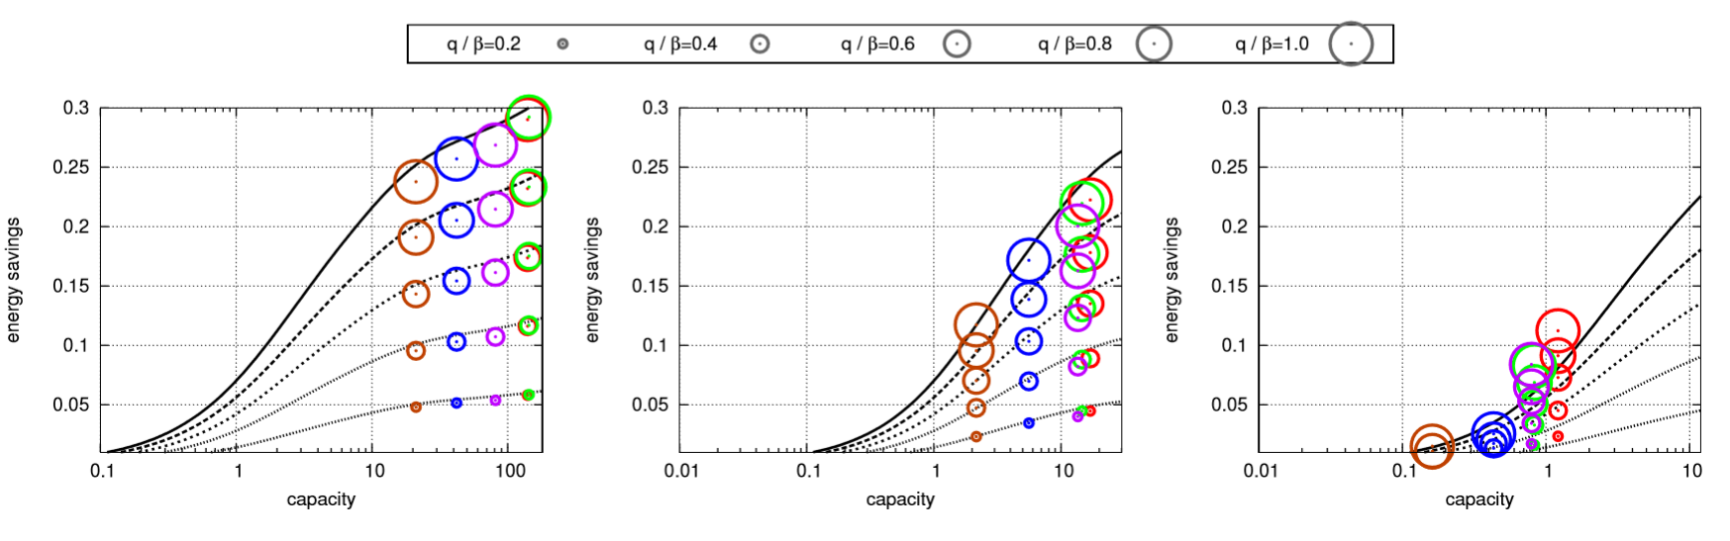
Swarm Size vs Energy Savings
O ISP 1 O ISP 2 O ISP 3 O ISP 4 O ISP 5
Theory matches practical savings
Popular (100k views)
Semi-Popular (10k views)
Unpopular (1k views)
Notes:
How theoretical savings fit the practical savings

Slide 9
Savings across the corpus
18% of average energy savings per day
Energy Savings (S)
Day

Slide 10


Incentivizing Users at System level
Energy Savings (S)
Swarm capacity (c)
Notes:
Two major players
CDN is doing nothing
User Uploading all time – why?
One part benefiting – one part suffering
Why we need to do this?
We see this as carbon credits.

Slide 11
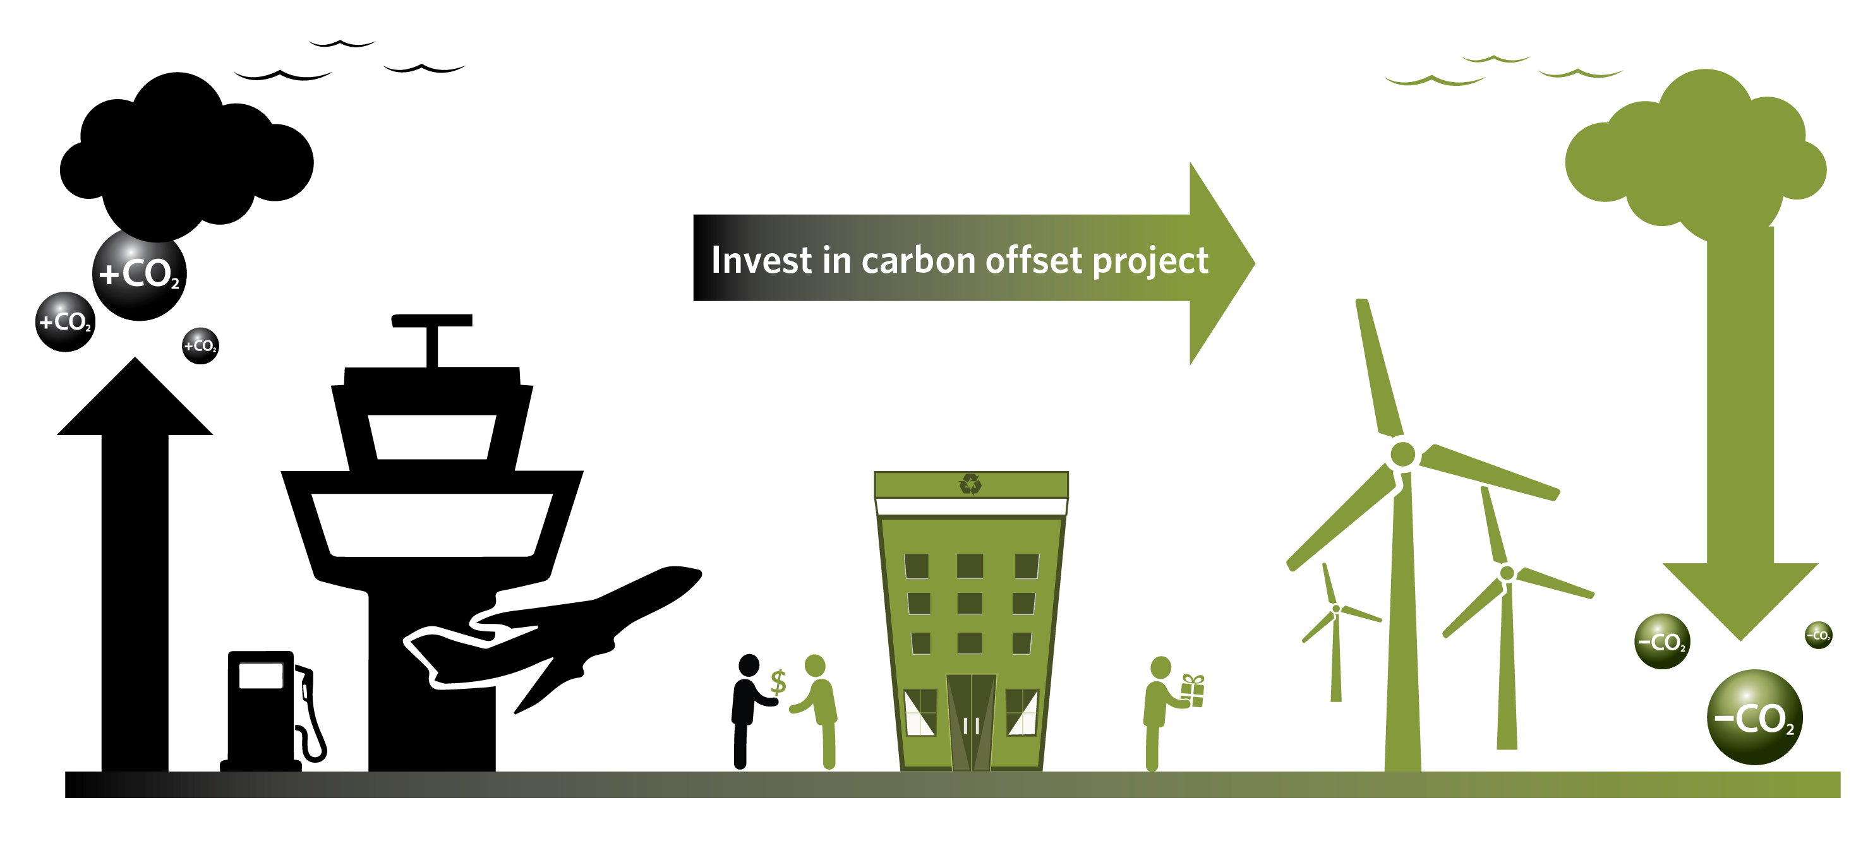
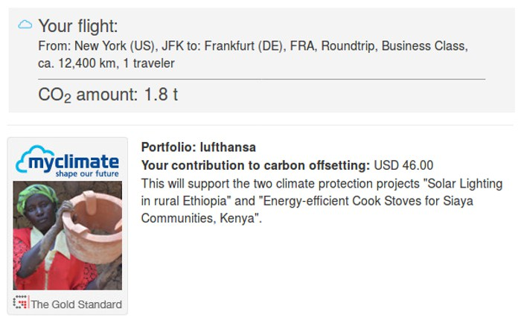
Carbon Credits
Notes:
What are these carbon credits?
when you booked your flight ticket you might have noticed – offsetting carbon

Slide 12
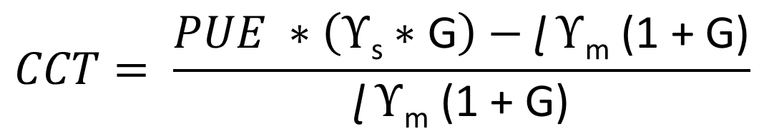
Carbon Credit Transfers
$$CCT= \frac{PUE ∗\left(ϒ\text{s}∗\text{G}\right)−\text{ɭ }ϒ\text{m} \text{(1 + }\text{G}\text{)}}{\text{ɭ }ϒ\text{m} \text{(1 + }\text{G}\text{)}}$$

Slide 13
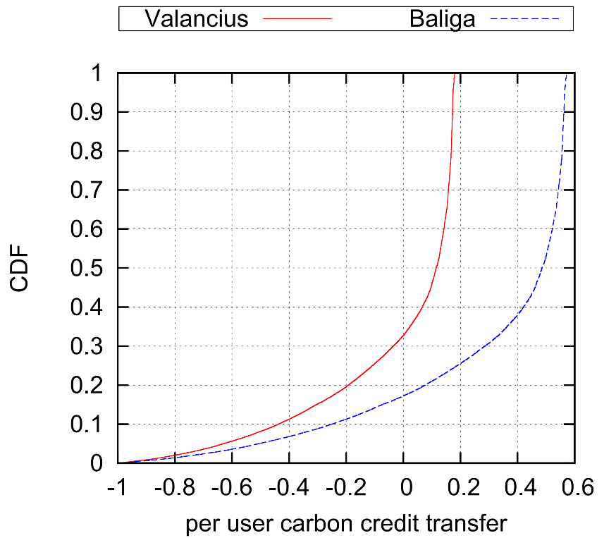
So, Carbon Neutral?
80% the users become carbon positive

Slide 14
Cache and Share?

Slide 15

Cache and Share?
ExP
PoP
Internet
Core Router
15
Notes:
Advantages of caching than p2p

Slide 16
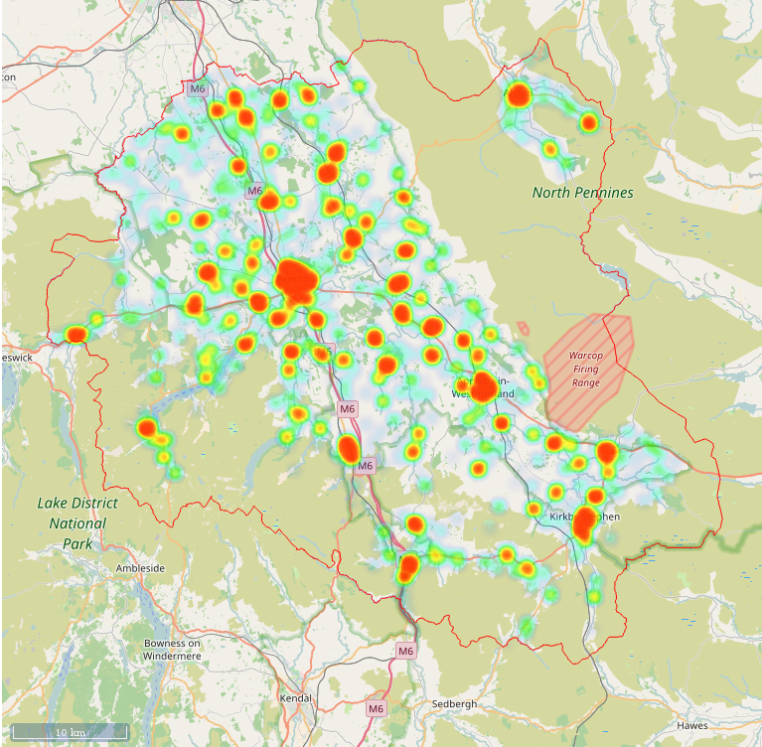

Feasible?
Eden (25/sq.km)
Boston (183/sq.km)
Cambridge (3193/sq.km)
Hammersmith and Fulham (11213/sq.km)
Milton Keynes (847/sq.km)
Luton (4993/sq.km)

Slide 17
How to Share?
Wi-Stitch
Who Operates?
  MNOs and Fixed line ISP
  Content Providers
How do users access?
  WiFi
  mmWave
  Cellular network
How to locate content?
  ICN
  NFV/SDN
  HTTP/DNS redirection

Slide 18
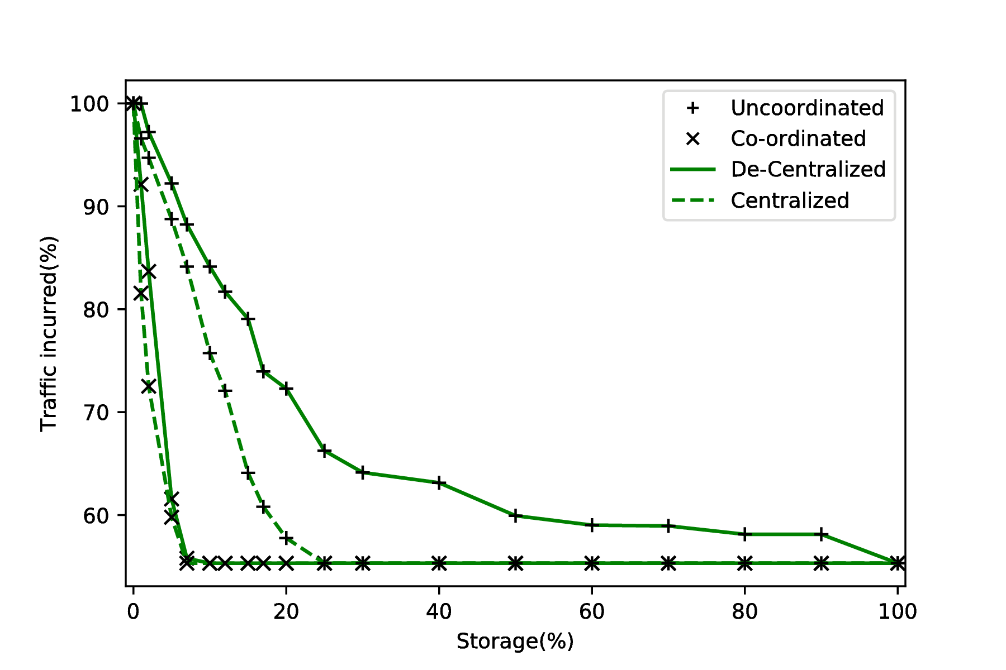
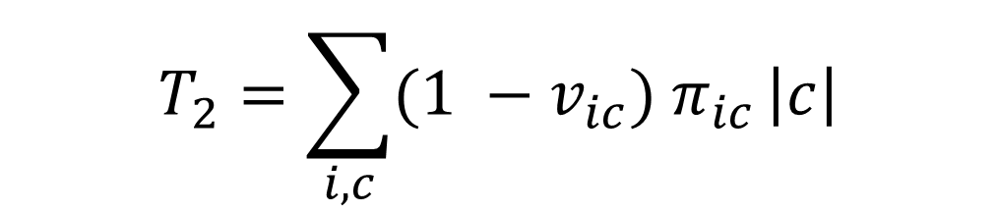
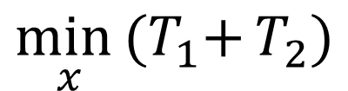
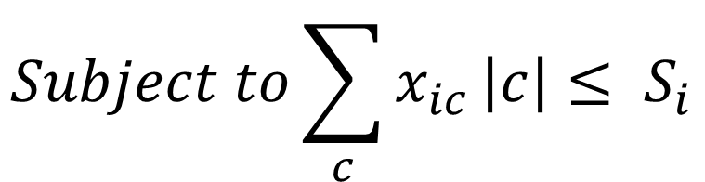
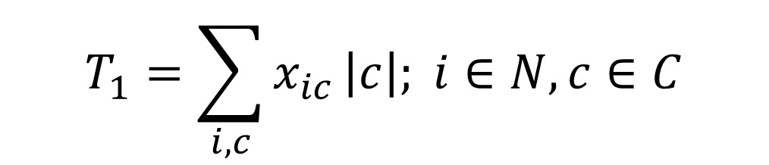
Store and Share (optimally)
$$T_{1}=\sum_{i, c}{x_{ic}}\left|c\right|; i∈N,c∈C$$
$$T_{2}=\sum_{i, c}{{(1 −v}_{ic}) π_{ic}}\left|c\right|$$
$$\min_{x}{{(T}_{1}+}T_{2})$$
$$Subject to\sum_{c}{x_{ic}}\left|c\right|≤ S_{i}$$

Slide 19

Upto 30% of energy savings
Go Green, in fact Carbon positive
[Best Paper] Aravindh Raman, Nishanth Sastry, Arjuna Sathiaseelan, Jigna Chandaria and Andrew Secker. Wi-Stitch: Content Delivery in Converged Edge Networks. In Proceedings of SIGCOMM MECOMM (2017)
Aravindh Raman, Dmytro Karamshuk, Nishanth Sastry, Andrew Secker and Jigna Chandaria. Consume Local: Towards Carbon Free Content Delivery In 38th IEEE ICDCS (2018).
Aravindh Raman, Nader Mokari, Mostafa Salehi, Tooba Faisal, Andrew Secker, and Jigna Chandaria Care to Share? An Empirical Analysis of Capacity Enhancement by Sharing at the Edge, Mobicom EdgeTech Workshop (2018)
.

Slide 20
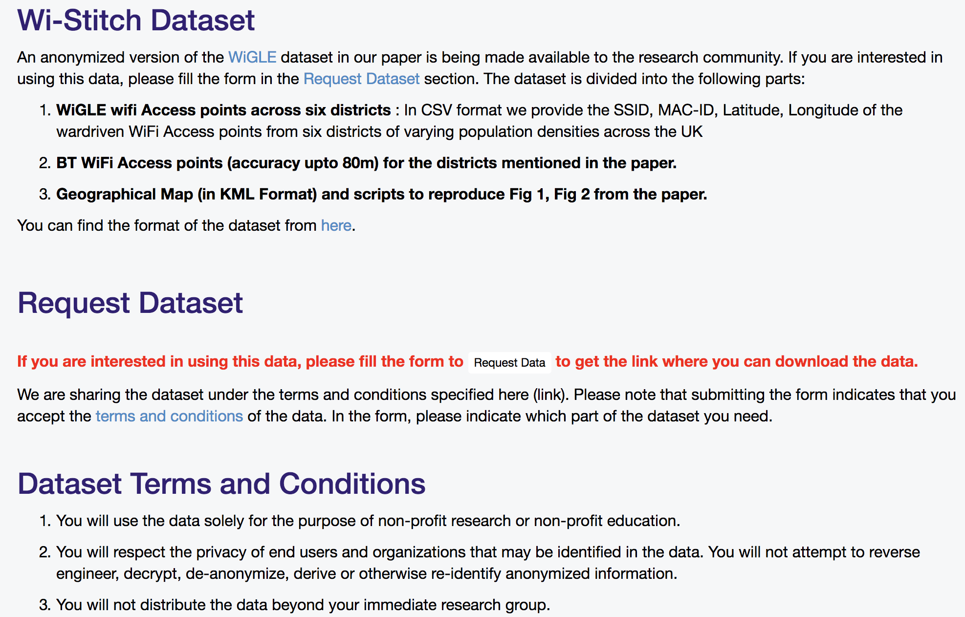
[Dataset available] See https://bit.ly/wi-stitch
20
20

Slide 21
[WIP (Please get in touch if interested!)]
When does sharing become feasible?
  Clearly works for BBC but won’t work for Parliamentlive.tv ☺
Rough model
  Users are picking content items from a bin (e.g., based on power law)
  Users then clump together into cells (e.g., some point process, which is inhomogenous to induce clumping into villages)
As a graph:
  Colour nodes based on content item
  Probabilistically induce edges based on closeness
  When does each colour of the graph become connected?

Slide 22
Upto 30% of energy savings
Go Green, in fact Carbon positive
[Best Paper] Aravindh Raman, Nishanth Sastry, Arjuna Sathiaseelan, Jigna Chandaria and Andrew Secker. Wi-Stitch: Content Delivery in Converged Edge Networks. In Proceedings of SIGCOMM MECOMM (2017)
Aravindh Raman, Dmytro Karamshuk, Nishanth Sastry, Andrew Secker and Jigna Chandaria. Consume Local: Towards Carbon Free Content Delivery In 38th IEEE ICDCS (2018).
Aravindh Raman, Nader Mokari, Mostafa Salehi, Tooba Faisal, Andrew Secker, and Jigna Chandaria Care to Share? An Empirical Analysis of Capacity Enhancement by Sharing at the Edge, Mobicom EdgeTech Workshop (2018)
.

Slide 23
Back up slides

Slide 24

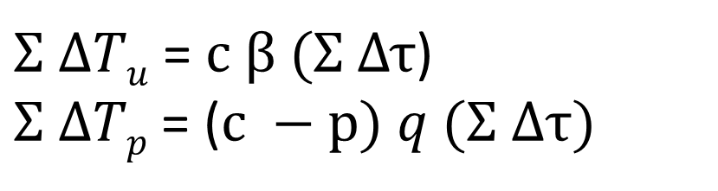
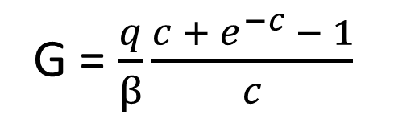
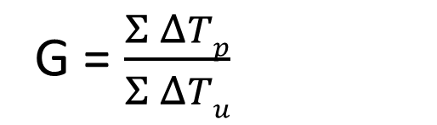
Traffic Gain
G = $\frac{Σ ΔTp}{Σ ΔTu}$
$Σ ΔTu$ = $c β (Σ Δτ$)
$Σ ΔTp$ = ($c −p) q (Σ Δτ)$
G = $\frac{q}{β}\frac{c + e^{−c} − 1}{c}$
swarm capacity can be modelled as M/M/∞
=> p = 1 − e^{−c}

Slide 25


Per-bit cost from servers
G
$ψ$_{s}
$ψ$_{p}
S
$ψ$_{s} = $PUE \left(ϒ\text{s} \text{+} ϒ\text{CDN}\right)$ + ɭ $ϒ\text{m}$
PUE => power usage efﬁciency metric of the network
ɭ => is the energy “loss” for end-user equipment.

Slide 26

Per-Bit Energy Consumption for P2P trafﬁc
$ϒ\text{p}\text{2}\text{p}\text{(}\text{L}\text{)}$ = $ϒ\text{ex}\text{p}\text{(}\text{L}\text{) (}P\text{exp}\text{(}\text{L}\text{)) }$
$\text{+}$ $ϒ\text{pop}\text{(}\text{L}\text{) (}P\text{po}\text{p}\text{(}\text{L}\text{) − }P\text{ex}\text{p}\text{(}\text{L}\text{))}$
$\text{+} ϒ\text{c}\text{o}\text{re}\text{(}\text{L}\text{) (}P\text{core}\text{(}\text{L}\text{) − }P\text{pop}\text{(}\text{L}\text{))}$
ExP
PoP

Slide 28


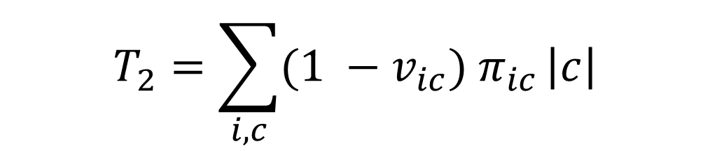
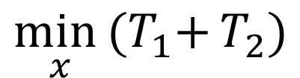
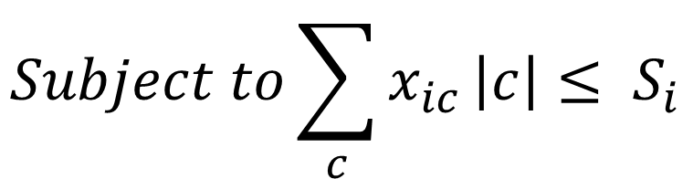
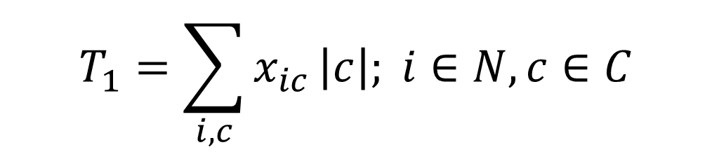
Store and Share (WIP)
$$T_{1}=\sum_{i, c}{x_{ic}}\left|c\right|; i∈N,c∈C$$
$$T_{2}=\sum_{i, c}{{(1 −v}_{ic}) π_{ic}}\left|c\right|$$
?
$$\min_{x}{{(T}_{1}+}T_{2})$$
$$Subject to\sum_{c}{x_{ic}}\left|c\right|≤ S_{i}$$

Slide 29
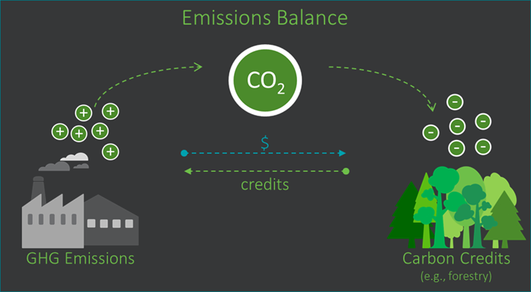
Carbon Credits
Notes:
Markets for carbon credits

Slide 30
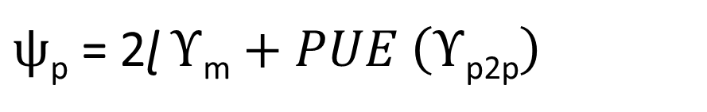
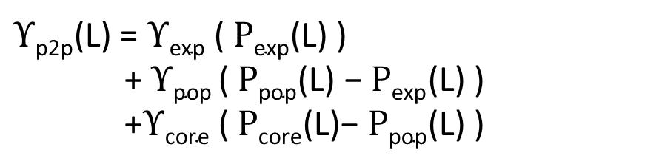

Per-bit cost for P2P
G
$ψ$_{s}
$ψ$_{p}
S
$ψ$_{p} = 2ɭ $ϒ\text{m}+PUE \left(ϒ\text{p}\text{2}\text{p}\right)$
$ϒ\text{p}\text{2}\text{p}$(L) = $ϒ\text{ex}\text{p}$ ($P\text{exp}$(L) )
+ $ϒ\text{p}\text{op}$($P\text{p}\text{op}$(L) − $P\text{exp}$(L) )
+$ϒ\text{core}$ ($P\text{core}$(L)− $P\text{p}\text{o}\text{p}$(L) )

