Slide 1
A novel approach to verification of distributed system performance
Presentation for Mathematics of Networks Workshop, April 2019
Peter.Thompson@pnsol.com
Notes:
Abstract: A key risk for time-critical distributed systems is that the performance will be unacceptable and/or uneconomic to deliver. Mitigating this risk requires an approach that supports both prospective validation and post-facto verification that should: capture performance requirements and resource constraints; validate them; construct performance properties/invariants that witness those requirements; and support the reification and abstraction of such properties/invariants throughout the System Development Life-Cycle. Here, we present a novel approach to prospective performance and resource consumption validation called the ∆Q framework, based on the use of improper random variables, which addresses these issues.

Slide 2
PEnDAR project
Goals
Partners
Consider how to enable Validation & Verification of cost and performance
for distributed and hierarchical systems
using developments of well-tried tools
supporting both initial and ongoing incremental development
Provide early visibility of cost/performance hazards
avoiding costly failures
maximising the chances of successful in-budget delivery of acceptable end-user outcomes
Supported by:
Notes:
PEnDAR - Performance ENsurance by Design, Analysing Requirements TSB REFERENCE: 132304
Why? Seeing cost/performance hazards becoming visible late in the development process – too late to save some projects! Multi-$B problem worldwide
Pressure to re-purpose commodity infrastructure for safety/mission-critical objectives; need to be able to articulate a safety case.

Slide 3
Focus on performance
Functional correctness is not enough

Slide 4
Nature of performance
In an ‘ideal world’, systems would always respond instantaneously
and without exceptions/failures/errors
In practice this doesn’t happen
there is always some delay and some chance of failure: some attenuation
Thus performance is a privation
the absence of attenuation
like ‘darkness’ or ‘silence’
Quantity also matters
require a certain rate or volume of responses with a given bound on attenuation

Slide 5
Measure of performance: ∆Q
∆Q is a measure of the ‘quality attenuation’ of an outcome
the extent of deviation from ‘instantaneous and infallible’
nothing in the real world is perfect so ∆Q always exists
∆Q is conserved
a delayed outcome can’t be ‘undelayed’
a failed outcome can’t be ‘unfailed’
∆Q can be traded
e.g. accept more delay in return for more certainty of completion
∆Q has an algebra
can manipulate it mathematically
∆Q is composable
supports hierarchical analysis

Slide 6
Application performance depends only on ∆Q
Components of a distributed application (e.g. a client and a server) exchange information as streams of packets
if those packets were all delivered instantaneously and the computational components performed correctly, the application would be guaranteed to work
however, there is always quality attenuation, ∆Q
Whether the application delivers fit-for-purpose outcomes depends on the magnitude of the attenuation
and the application's sensitivity to it
the layering of network protocols isolates the application from any other aspect of the packet transport.
Notes:
To the application the network is a necessary evil that delays and loses packets!

Slide 7
Sources of attenuation
Process algebra
Stochastic process algebra
∆Q Framework
Causality
Synchronisation
Imperfection
Information:
Takes time!
Explicit
Implicit: resource sharing
Discrete
Exceptions
Failures
Computed
Communication
Exclusive
Discrete:
Locks etc
Long timescales
Statistical
Continuous:
CPU, interface…
Short timescales
Data dependency
Statistical
Communicated
Resource exhaustion

Slide 8
∆Q in networks
Exchanging information via streams of packets sharing network resources gives tremendous flexibility, but introduces an element of chance
because the state of the network when any given packet is inserted is unknowable, exactly what will happen to it is uncertain
∆Q in statistically-multiplexed networks is thus necessarily a probabilistic measure
can be represented by an improper random variable
encompassing normal behaviour and exceptions/failures in one model

Slide 9
Representation of ∆Q
1.0
0.9
0.8
If we write ∆Q(x) for the probability that an outcome occurs in a time t < x, then the tangible mass T is defined by:
The intangible mass is simply 1 - T
Intangible mass encodes probability of exception/failure
0.7
0.6
Cumulative probability
0.5
0.4
$$T\left(∆Q\right)=\lim_{x→∞}\left.∆Q(x\right)$$
Tangible mass encodes distribution of response time
0.3
0.2
0.1
0.0
2
4
6
8
10
12
14
16
Response time

Slide 10
Outline of a coherent methodology

Slide 11
Performance/resource analysis
Starting with a functional decomposition:
Take each subsystem in isolation
analyse performance
modelling remainder of system as ∆Q
quantify resource consumption
may be dependent on the ∆Q
Examine resource sharing
within system – quantify resource costs
between systems – quantify opportunity cost
Successive refinements
consider couplings
iterate to fixed point
Sub-system
Quantitative Timeliness Agreement
Sub-system
∆Q
Sub-system
Shared resources
Notes:
A Quantitative Timeliness Agreement (QTA) is a relationship between the demand (the applied load, including its pattern) and the delivered quality attenuation (as a probability distribution, ∆Q)
Opportunity cost between one system and another sharing the same resources, and successive refinements won’t be considered in this webinar.

Slide 12
Quantifying intent
The key challenge is to establish quantified intentions
for outcomes/resources/costs
Then a variety of mathematical techniques can be applied
queuing theory
large deviation theory
∆Q algebra
This is “only rocket science”
not brain surgery!
set of tools already developed
Notes:
Rocket science used to be something only world superpowers could do – now you only need to be a billionaire! It’s well enough understood to be reproducible, and is just (complex) engineering. Brain surgery requires experience, skill and gut feel – not easy to teach! Outcomes are hard to quantify.

Slide 13
Quantifying timeliness
Outcome requirement:
Suppose we had a specification for how long it’s acceptable to wait for a system outcome:
50% of responses within 5 seconds
95% of responses within 10 seconds
99.9% of responses within 15s
0.1% failure rate
This can be represented by an improper CDF
1.0
0.9
0.8
0.7
0.6
Cumulative probability
0.5
0.4
0.3
0.2
0.1
0.0
2
4
6
8
10
12
14
16
Notes:
A key challenge is to quantify timeliness rather than simply rates – this is key for any individual end user.
Let’s suppose we could agree how long it’s OK to wait for the first frame of a chosen video to start.
This is the “specification” as a CDF of the observable outcome – it represents the “worst case” observable behavior that would still fulfill the requirement
We are also defining that responses received after 15 seconds and loss are indistinguishable outcomes (from our point of view).

Slide 14
Meeting a timeliness requirement
Suppose the black line shows the delivered CDF
from measurement, simulation or analysis
This is everywhere above and to the left of the requirement curve
this means that the timeliness requirement is satisfied
if not, there is a performance hazard
1.0
0.9
0.8
0.7
0.6
Cumulative probability
0.5
0.4
0.3
0.2
$(∀x {ΔQ}_{1}\left(x\right)≤ {ΔQ}_{2}(x))⟹({ΔQ}_{1}≥{ΔQ}_{2}$)
0.1
0.0
2
4
6
8
10
12
14
16
Response time
Notes:
Any CDF whose curve is always to the left and above this one represents an outcome that is “acceptable”. If the black line crosses the blue line we have a performance hazard.

Slide 15
Validating performance requirements
Decompose the performance requirement following system structure
using engineering judgment/best practice/cosmic constraints
creates initial subsystem requirements
Validate the decomposition by re-combining via the behaviour
formally and automatically checkable
captures interactions and couplings
Necessary and sufficient:
IF all subsystems function correctly and integrate properly
AND all subsystems satisfy their performance requirements
THEN the overall system will meet its performance requirement
Apply this hierarchically until
behaviour is trivially provable OR
have a complete set of testable subsystem verification/acceptance criteria
Notes:
This can be combined with a corresponding analysis of the resource consumption

Slide 16
Simple quantitative worked example

Slide 17
Generic RPC
1 Construct transaction
2
Send request
3
Receive request
4
Process request
0
Idle
Front end
Network
Back end
8
Complete transaction
7
Receive Response
6 Transmit Response
5
Commit results
Notes:
We consider a very generic remote procedure call in which a front end (which could be a web browser, an embedded sensor, a smart meter etc.) engages with a transaction across a network with a back end that includes an interaction with a database of some sort. This is illustrated in this slide, which shows the system components in blue and the typical sequence of events as numbered circles. RPC is a common design pattern:
DNS lookup
Web request
IoT sensor system
Billing system e.g. smart meters

Slide 18
Generic RPC - observables
∆Q(A⇝B)
∆Q(B⇝C)
A
1 Construct transaction
B
2
Send request
3
Receive request
C
4
Process request
0
Idle
Front end
Network
Back end
∆Q(C⇝D)
8
Complete transaction
7
Receive Response
6 Transmit Response
5
Commit results
F
E
D
∆Q(E⇝F)
∆Q(D⇝E)
Notes:
We measure the performance of the system on the basis of passage times between the labelled observation points A - F, which we characterise using improper random variables, ∆Q.

Slide 19
Generic RPC – abstract performance
A
1 Construct transaction
B
2
Send request
3
Receive request
C
0
Idle
Front end
Network
∆Q(C⇝D)
8
Complete transaction
7
Receive Response
6 Transmit Response
F
E
D
Notes:
From a quality attenuation perspective, we can ‘roll up’ the last stage of the process into a ∆Q – from the viewpoint of the rest of the system, how the transition from C to D occurs is irrelevant, we are just interested in how long it might take and how likely it is to fail (its ∆Q).

Slide 20
Generic RPC – abstract performance
A
1 Construct transaction
B
0
Idle
Front end
∆Q(B⇝E)
8
Complete transaction
F
E
Notes:
In the same way we can combine the network portions with the back end to give a composite ∆Q.

Slide 21
Generic RPC – abstract performance
A
0
Idle
∆Q(A⇝F)
F
Notes:
Finally we can roll up the front end behaviour to give the ∆Q for the whole system. This is the quality attenuation from the ‘user’ point of view, which is where we can start to impose requirements.

Slide 22
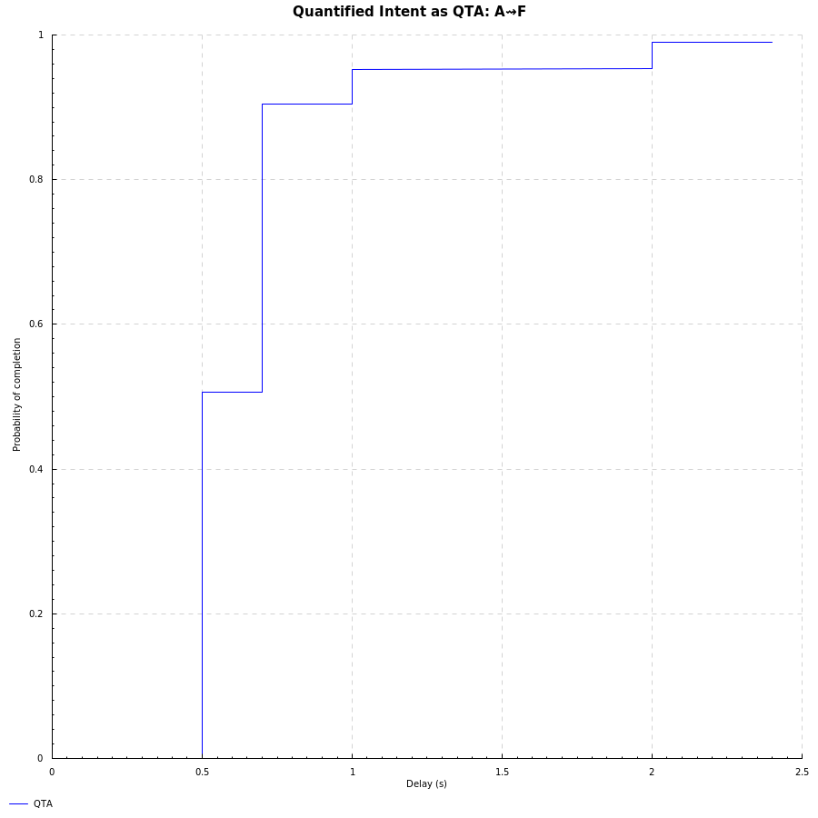
Performance requirement
User performance requirement is a bound on ∆Q(A⇝F), e.g.
50% within 500ms
95% within 750ms
etc.
Decompose this as ∆Q(A⇝F) = ∆Q(A⇝B) ⊕ ∆Q(B⇝E) ⊕ ∆Q(E⇝F)
How these terms combine depends on the behaviour
Notes:
This is where we need to bring in a quantitative intent: how rapidly and reliably we want the system to perform. Here we choose some numbers for the sake of an example, which are plotted on the right as a CDF.

Slide 23
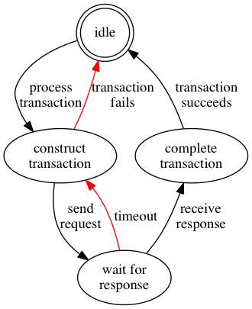
Front-end behaviour (1)
Since the request or its acknowledgement may be lost, the process retries after a 333ms timeout
failure mitigation
After three attempts the transaction is deemed to have failed
failure propagation
Can unroll the loop for a clearer picture
A
F
B
E
Notes:
We show the state diagram for the front-end process. Note that not every situation has an explicit notification of failure as we do here.
We’ll get round to C and D later!

Slide 24
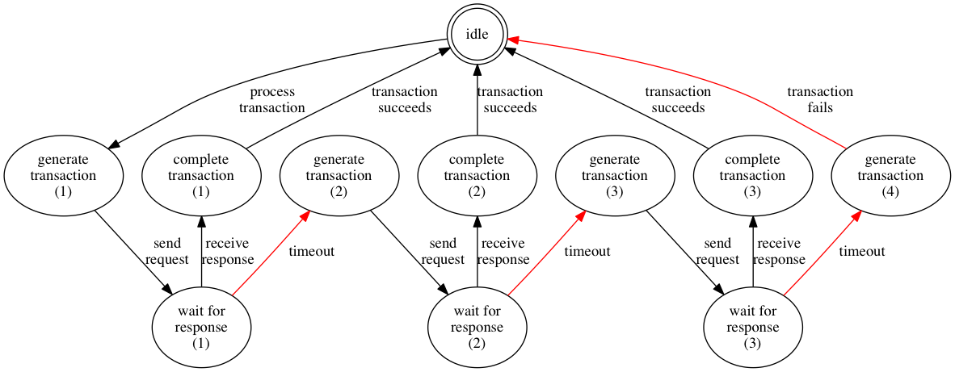
Front-end behaviour (2)
Notes:
If N=4 we can unroll the process like this. We have a non-preemptive first-to-finish synchronisation between receiving the response and the timeout. Which route is taken is a probabilistic choice, shown here with blue and green examples. Which path is taken depends on the ∆Q of the B – E path, represented here by the ‘wait for response’ states.

Slide 25
Performance analysis (1)
We have a non-preemptive first-to-finish synchronisation between receiving the response and the timeout
Which execution path is taken is a probabilistic choice depending on the ∆Q(B ⇝E)
combine the ∆Qs of the different paths with these probabilities
Assumptions:
For an initial customer deployment over UK broadband with the server in the US East Coast:
∆Q(B⇝C) and ∆Q(D⇝E) the same:
minimum delay 95ms
50ms variability
1-2% loss
∆Q(C⇝D) uniformly distributed between 25ms and 60ms
Notes:
The network characteristics are assuming communication between a UK-broadband-connected front-end and a US East Coast cloud-located server.
Combining ∆Qs means convolving the corresponding probability distributions – this is mathematically quite straightforward and computationally inexpensive.

Slide 26
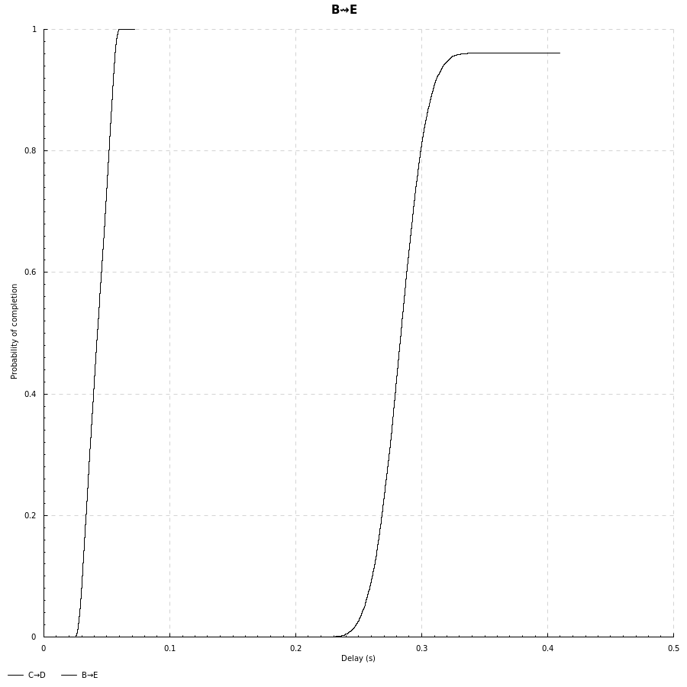
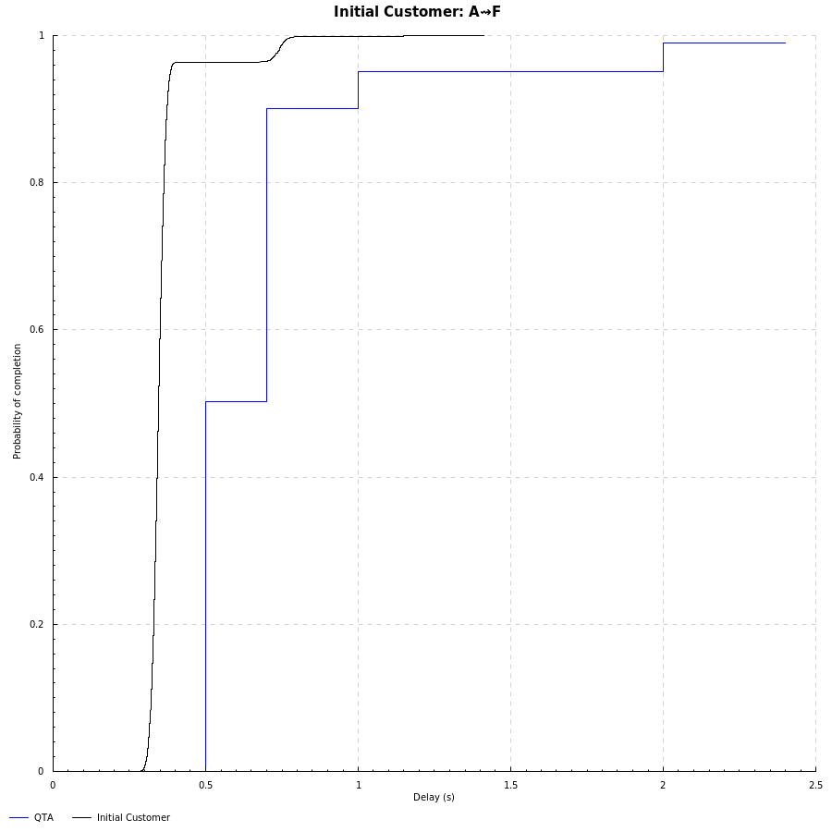
Performance analysis (2)
∆Q(C⇝D)
∆Q(A⇝F)
∆Q(B⇝E)
Requirement
Notes:
The first curve shows the server response ∆Q, the second its convolution (twice) with the network transport ∆Q.
On the right we see the result of combining this with the behaviour of the front-end, compared with the performance requirement.

Slide 27
Verification
So far, the verification task seems straightforward:
provided the network and server performance are within the given bounds, then the front end will deliver the required end-user experience
However, this seems to have plenty of slack
can we validate a different set of requirements?
how far can we relax them?
With this model we can explore:
varying the network performance
e.g. an alternate server on the US West Coast, with more routing choices
varying the server performance (e.g. as a result of load)
not today!
Notes:
Having constructed a model, it is now easy to experiment with varying some parameters.

Slide 28
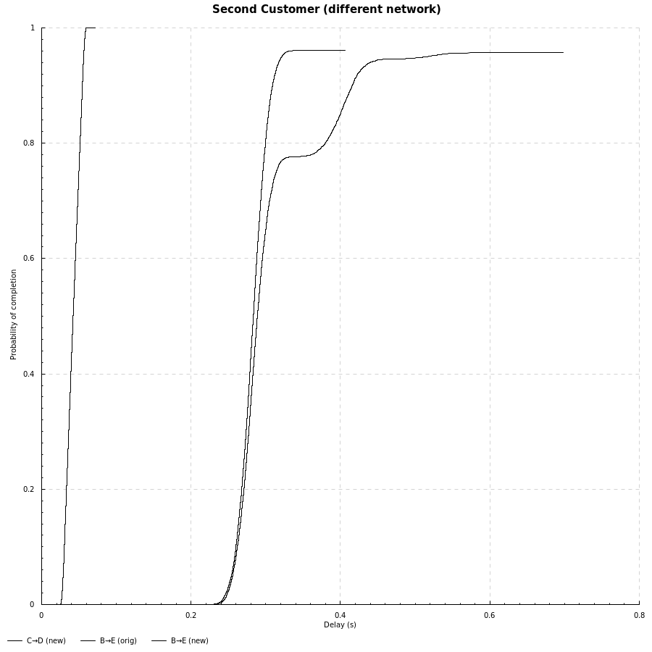
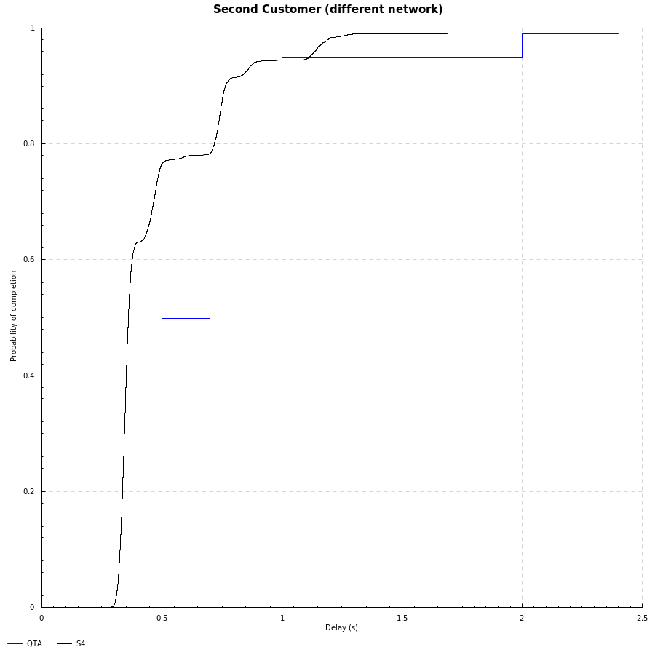
Performance analysis (3)
∆Q(B⇝E)
∆Q(C⇝D)
∆Q(A⇝F)
Requirement
Notes:
The server performance is the same but the network has higher delays – equivalent to having an alternate server on the US West Coast, with more variety of routing choices.
We can see on the right that the resulting overall ∆Q no longer meets the requirement.

Slide 29
Summary
System performance validation consists of:
analysing the interaction of system behaviour and subsystem performance requirements
showing that this ‘adds up’ to meet the quantified requirements (QTA)
System performance verification consists of showing that subsystems meet their QTAs
by analysis and/or measurement of ∆Q of the subsystems’ observable behaviour
This provides acceptance and/or contractual criteria for third-party subsystems or services
substantially reduces performance integration risks and hence re-work

Slide 30
Thank you!

Slide 31
Backup slides

Slide 32
Server resource consumption
Virtualised server has a limit on the rate of I/O operations
So that the underlying infrastructure can be reasonably shared
Such parameters affect the OPEX
Typically access is controlled via a token-bucket shaper
Allows small bursts
Limit long-term average use
This constitutes a QTA
Need to verify both sides
Delivered performance of the virtualised I/O thus depends on recent usage history
Load is a function of number of front-ends accessing the service and the proportion of re-tries
Re-tries depend on the ∆Q(B ⇝E) – which in turn depends on the performance of the I/O system!
This has been modeled here via a probability of taking a ‘slow path’ in the server

Slide 33
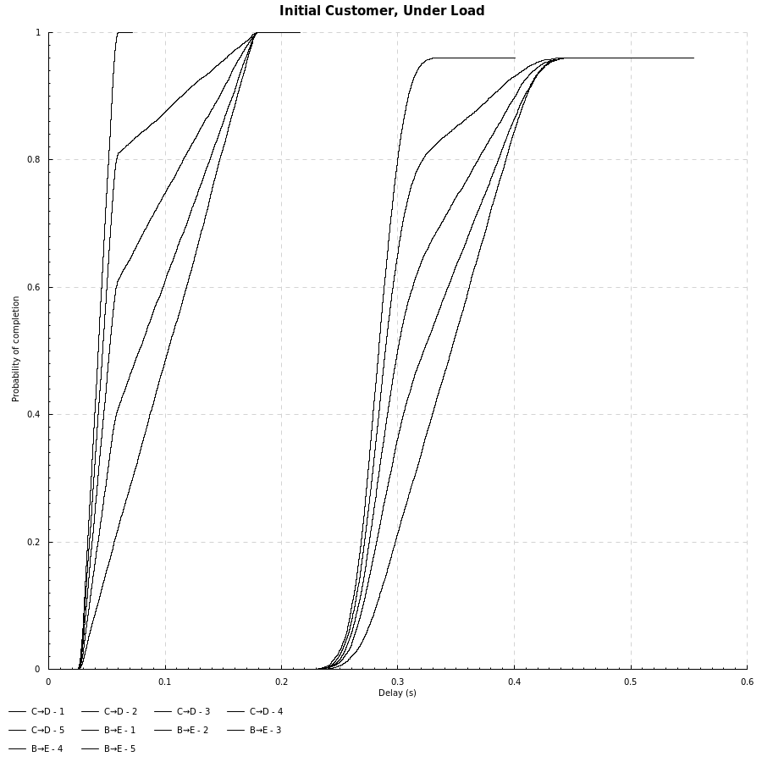
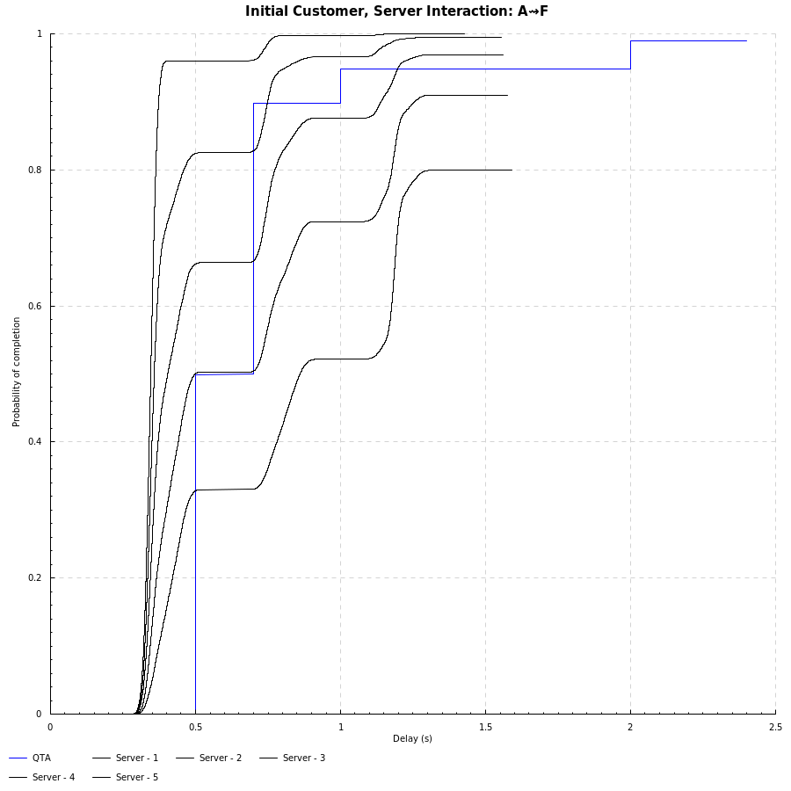
Performance analysis (4)
∆Q(B⇝E)
∆Q(A⇝F)
∆Q(C⇝D)
Requirement
Notes:
We now add in a probability of the server following a ‘slow path’ (which could be as a result of load exceeding an aspect of the virtualisation constraint), modeled as a uniform delay of between 15ms and 150ms. On the left we have five ∆Q curves for the server response, with the slow path probability varying from 0% (the original curve) to 25%, 50%, 75% and 100%.
On the right we see the ∆Q resulting from combining this with the front-end behaviour; even a 25% chance of following the slow path breaks the performance requirement.

Slide 34
Capturing interactions
Notes:
We’re now going to run through some of the technical dimensions of this challenge

Slide 35
Exception/failure
System impact
Mitigation
Individual impact
Individual impact
Propagation
Capacity
Distance
Outcomes Delivered
Resources Consumed
Scale
Time
Space
Density
Number
Schedulability
Correlation
Self-induced
System impact
Variability
Externally created
Notes:
This captures what we have learnt about system delivery problems over the last decade. There’s a lot here so we’re going to break it down!

